Slide 1


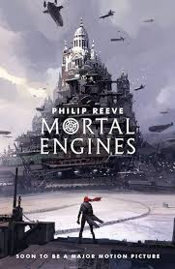
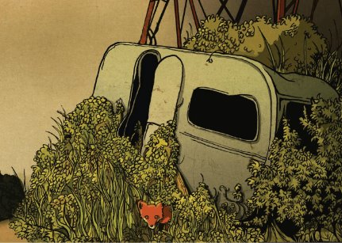
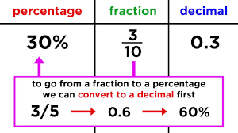
Year 6 Newsletter
Spring 1—2024/2025
Key Dates
Monday 6th January – Term starts
Friday 17th January – INSET
Friday 14th February – Last day of term
Notices and Reminders
PE day will continue to be on a Monday. Please make sure children wear the correct PE kit and trainers.
Please ensure children have a fully stocked pencil case ready for the new term.
Homework: set weekly on Fridays and due in the following Friday.
Reading: 5 times per week
TTRS: 3 times per week
Reading
This half term in reading, the children will continue to deepen their understanding of how to answer a range of comprehension questions linked to the book, Mortal Engines by Phillip Reeve. There will be opportunities for rich discussion and thought-provoking
questions that challenge the
children to think hard and
articulate their ideas clearly.
The common themes from the
book include friendship and social
classes.
Writing
In language lessons this half term the children will be learning to identify and use colons, semi-colons and dashes to either add extra information to a sentence or in a list. Children will also have the opportunity to write two different types of narrative: a warning tale and a wishing tale. The children will plan, draft and write their own
stories that follow the
same structure as a
well-known text.
Maths
In maths this half term, the children will continue to work hard on algebra by representing and solving a variety of equations. Later in the term, they will delve into the world of fractions, decimals and percentages. They will learn how these forms relate to one another, explore equivalents, and build confidence in recognising and working with these concepts.

Slide 2
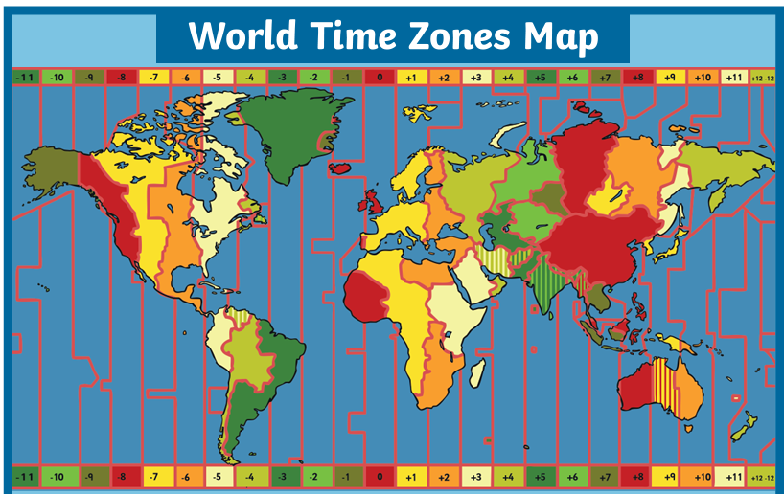

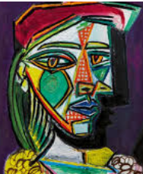




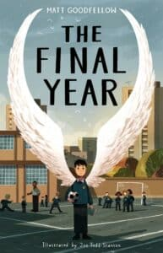

Science
In science this half term the children will learn about evolution, inheritance and fossils. The children will start by exploring how genes are passed on to offspring and then move on to Charles Darwin's studies and theory of evolution such as 'Darwin's finches' and how they adapted to suit their specific environment.
Geography
In geography this half term the children will be learning about time zones, six figure grid references and biomes around the world. They will then move onto the physical and human geography of Russia.
Art
PE
In PE the children will be learning gymnastics. The focus will move from handstands to cartwheels and rolls. By the end of the term, they will be creating their own sequences of movement.
In art this half term the children will study two artists- Picasso and Barbara Kruger. Inspired by their different artistic styles, the children will use their sketchbooks to plan and create their own exciting self-portraits.
Music
In music, the children will focus on improving their understanding of music theory and will be given the opportunity to listen to and appraise both classical and modern music. The theme for this half term will be centered around music and technology. The children will learn to play the recorder, improvise on the recorder and will compose music on a digital device.
PSHE
How can I look after my mental health?
It is important for children to learn how to be aware of their own, and others' mental health. Children will learn how mental health is different, but linked, to physical health. Children will learn how to identify strategies that support positive mental health, what might affect mental health and ways to implement positive routines into their daily life.
French
This half term the children will develop the knowledge and skills to present both orally and in written form about the pets they have and/or do not have in French. They will move from 1st person singular to 3rd person singular verb usage, so they are able to say what the pet is called and use conjunctions more confidently.
Suggested books for reading

