Slide 1
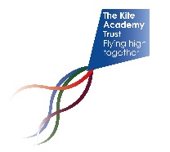
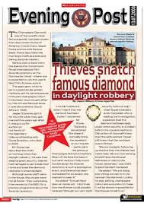
Year 5 Newsletter
Spring 1—2024/2025
Key Dates
Monday 6th January – Term begins
Friday 17th January – Inset day
Thursday 6th February – Y5 Trip the Living Rainforest
Monday 17th February – Friday 21st February – Half Term
Notices and reminders
Reading diaries – will be checked each week.
Homework - sent out on Thursday for BG and Friday for DA, returned by the following Thursday/ Friday.
PE – Thursday. Please ensure the children are in correct kit with sensible trainers.
Classroom Equipment – a handwriting pen, pencils, ruler, rubber, green pen, glue stick, a small set of colouring pencils all in a clear pencil case. A lidded drink bottle.
PLEASE ENSURE ALL SCHOOL ITEMS ARE NAMED
Reading
This term the children will continue reading 'Journey to the River Sea' by Eva Ibbotson. This is an adventure story following Maia, an orphan girl, who travels to South America to live with relatives. Much of the story is set in The Amazon Rainforest, which will link very
well with the geography unit for
this term. The children will
continue to develop their
comprehension skills through
careful analysis of the text and
related vocabulary.
Writing
In their language lessons, the children will be increasing their confidence in the use of direct speech. They will then be moving on to look at co-ordinating conjunctions.
During their composition lessons, the children will be learning about the features
of newspapers. This will begin by
learning a recount of a scarab
beetle invasion at school before
writing their own newspaper
recount.
Maths
The children will be learning to complete long multiplication calculations up to 4-digit numbers by 2-digit numbers, short division calculation with 4-digit numbers, dividing with remainders and solving multiplication and division problems. The children will then move on to a new fraction unit where they will learn how to multiply fractions by an integer and calculate fractions of an amount.

Slide 2
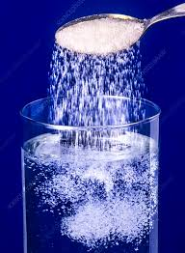
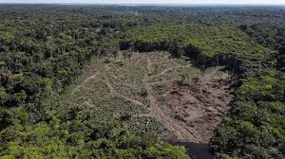
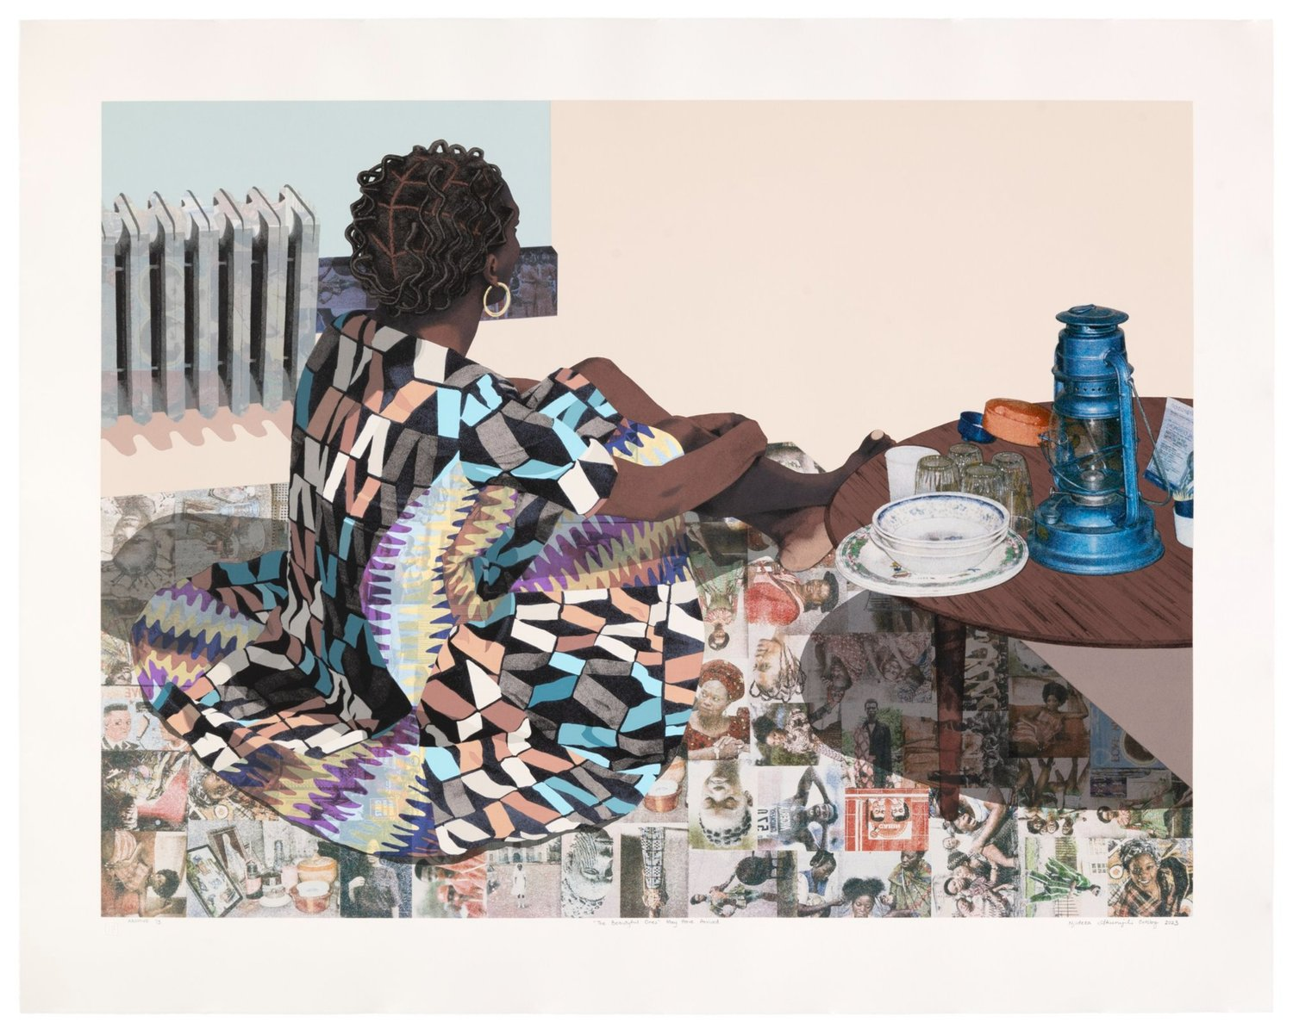
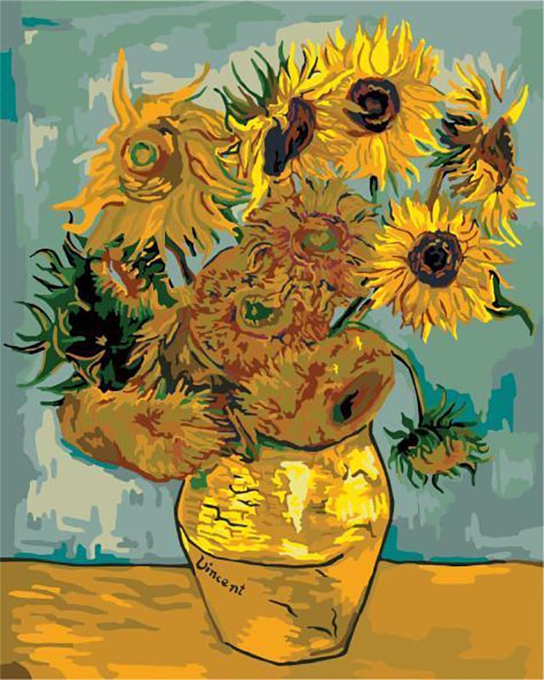
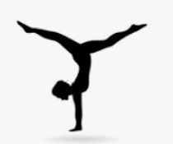
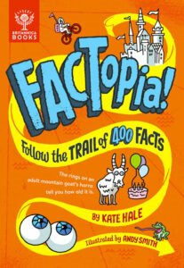
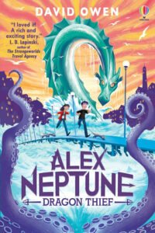
Science
In science the children are continuing learning about changes of materials. They will be planning a fair test to determine how the temperature of water affects
the speed of sugar dissolving.
Nearer the end of term, the
children will begin their unit
learning about Earth and space.
Geography
In geography the children are learning about the effects of deforestation on the Amazon Rainforest. They will explore the differences between biomes before learning about the geography of South America. The children will focus their studies on
Brazil, learning about
both physical and
human geography.
Art
In art the children will be creating their own mixed media painting, drawing on inspiration from the artwork of Vincent Van Gogh, Njideka Akunyili Crosby and Frida Kahlo. They will be learning about colour, tints and tones, as well as creating texture
through paint.
PE
In P.E. this half term, the children will be learning gymnastics. They will look at which different types of rolls they know including how to perform a backwards roll. The children will also be learning how to perform a handstand and a cartwheel. ​
Music
In music the children will be learning about the terms 'melody' and 'harmony'. They will increase their knowledge through listening and responding to gospel and orchestral music. They will also be developing their recorder playing skills further.
PSHE
By examining the various ways we can communicate in the modern world, the children will be looking to become better communicators. They will be spending time learning how to communicate safely with others across various media.
French
In French this term, the children will be learning how to say and write different stationery items that can be found at school.
They will be building their understanding of silent letters in French and know which version of 'my' to use
when talking
about different
items.
Suggested books for reading

