Slide 1


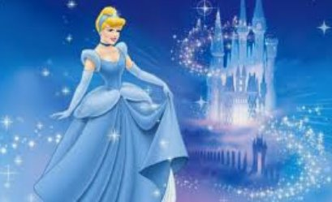

Year 4 Newsletter
Spring 1—2024/2025
Delete and insert academy logo
Key Dates
Monday 6th January – Term begins
Friday 17th January – Inset day
Monday 17th February – Friday 21st February – Half Term
Spring 2
Tuesday 25th February – school swimming begins for 6 weeks.
Notices and Reminders
TTRS – 5 minutes daily .
Homework - sent out on Friday returned by the following Friday.
PE – Tuesday. Please ensure the children are in correct kit with sensible trainers.
Classroom Equipment – pencils, ruler, rubber, green pen, glue stick, a small set of colouring pencils all in a clear pencil case. A lidded drink bottle.
PLEASE ENSURE ALL SCHOOL ITEMS ARE NAMED
Reading
This half term the children pick up as Tommo and the family are looking for Big Joe as he mysteriously vanished. Along the way, the children shall be using their inference skills to answer questions about how
characters are feeling, as
well as finding evidence to
back up our thoughts and
ideas – an important skill to
develop.
Writing​
In writing the children will be looking at the story of Cinderella. Their main focus in this unit will be on writing a detailed setting description using precise vocabulary. The children will then move onto The Royal Wedding. The focus in this unit of work will be on fact writing, ending with the children writing a newspaper report about the wedding.
Maths
In maths the children will be using and applying their skills in multiplication and division. They will be learning different formal and informal methods to help them, as well as how to apply the different facts that they know to help them. In addition, they will be continuing to develop their knowledge of times tables.

Slide 2
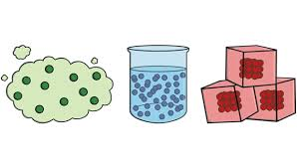
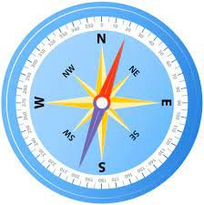
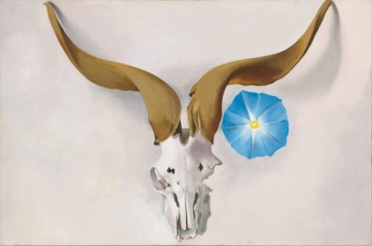
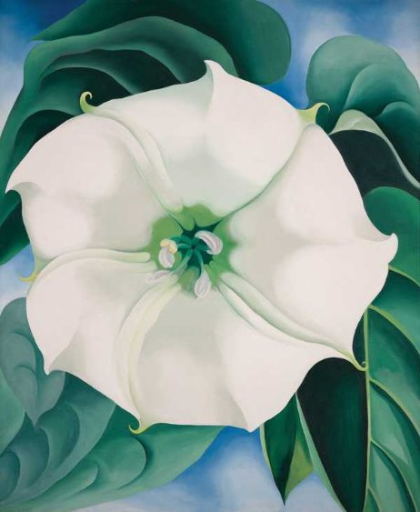
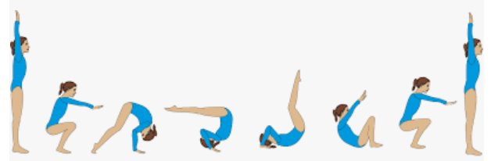

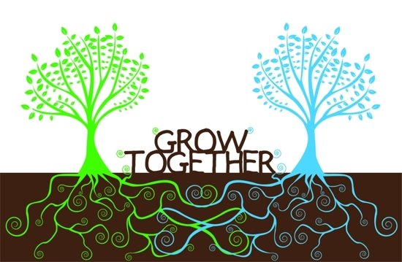

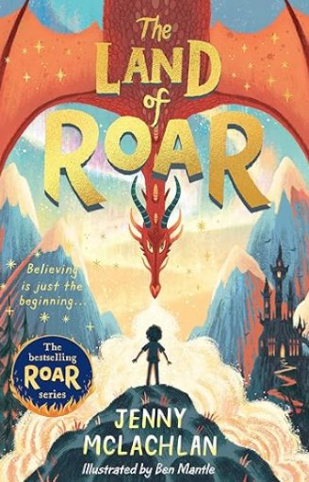

Science
In science this half term, the children will be learning all about the different states of matter around us and how the way these materials are structured give them different properties. They will be learning all sorts of technical vocabulary, so feel free to quiz them on what they've done!
Geography
In geography the children will learn how continents were formed, beginning with Pangea. The children will be introduced to latitude and longitude. We will create simple sketch maps and learn about compass points and grid references. We will look in detail at the continent of Asia.
Art
In art this half term, the children will be practicing their painting skills by creating and changing tertiary colours, tones and tints. Our focus will be on Georgia O'Keefe, an American artist, who was the first female in the modernist art movement. They will then be recreating one of her paintings and then creating their own work in her style, using the skills they have learned.
PE
In PE this half term, the children will be developing their flexibility, strength, technique control and balance while working through the gymnastics program. Each week they will be taught how to safely master different techniques such as rolls, shaped head stands and balancing positions.
Music
In music this half term, the children will be learning to play the recorder. They will learn several different notes and combine these to play along to a variety of music genres including reggae, soul and R&B.
P.S.H.E.
In PSHE this half term, the children will be learning about how we grow and change as we get older. They will be looking at some of the physical and mental changes that they will experience. They will also learn about ways that they can develop independence, both at home and at school, through their decisions and choices.
French
In French this half term, the children will be learning how to talk about time, as well as learning the days of the week and months of the year.
Suggested books for reading

