Slide 1


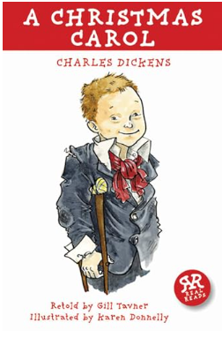
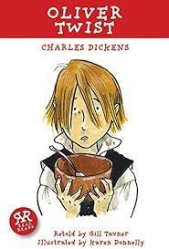
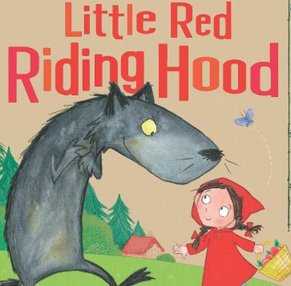
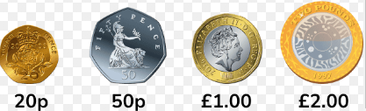
Year 2 Newsletter
Spring 1—2024/2025
Notices and Reminders
PE is on Friday. Please send you child to school in their PE kit.
Please bring their book and reading diary every day to school.
Key dates
Term begins - Monday 6th January 2025
Inset day - Friday 17th January 2025
Last day of Spring 1 - Friday 14th February 2025
Reading
Linking with last term's Victorian theme, we will finish reading A Christmas Carol by Charles Dickens before moving on to another of his popular works, 'Oliver Twist', with its gripping story and rich vocabulary.
Writing
This half term the children will focus on the texts 'Little Red Riding Hood' and will begin a letter to the wolf. In their English language lessons, the children will be learning all about different sentence types. Throughout the term, the children will continue to build their knowledge and understanding of spelling, punctuation and grammar.
Maths
This half term the children will learn to recognise and use symbols for pounds (£) and pence (p). They will also combine and find different combinations of coins equalling the same amounts. Using this knowledge, the children will then solve simple problems in a practical context involving addition and subtraction of money, including giving change. The children will begin the multiplication and division unit by recognising equal groups.

Slide 2
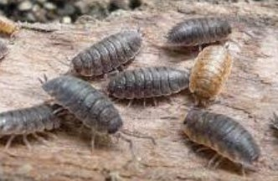
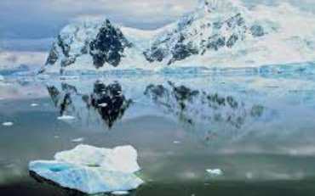
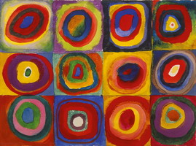
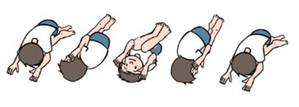


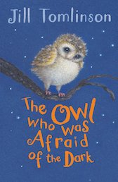
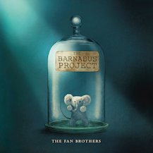
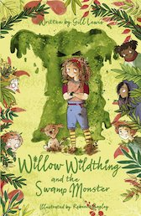
Science
In science the children will be learning how to identify and classify if something is alive, was once alive or has never been alive. The children will be exploring what a habitat is, and what makes a good habitat for a variety of plants and animals. Finally, the children will investigate food chains and learn how to construct one.
Geography
This term in geography, the children will begin to answer the question 'Why doesn't anyone live in Antarctica permanently?' The children will learn to locate Antarctica and identify its seasons and climate. They will then begin to learn the different plants and animals that can be found in Antarctica.
Art
In art the children will be learning about abstract painting in the style of Kandinsky. They will start by learning about tints and tones before extending their knowledge of secondary colours by learning and creating tertiary colours on a colour wheel. They will then create their own concentric circle inspired art.
PE
This half term the children will be doing gymnastics. They will be developing their skills from year 1, mastering basic movements including running, jumping, throwing and catching. Alongside this, they will be developing balance, agility and co-ordination and begin to apply these in a range of activities.
Music
This half term the children will be learning that music has a pulse (steady beat). It is made up of long and short sounds called rhythm as well as high and low sounds known as pitch. The children will have the opportunity to learn to play either a recorder or a glockenspiel.
PSHE
In PSHE the children will be exploring the question: What jobs do different people have? They will be learning the reasons why people have jobs and how people choose their jobs too. They will also spend time considering which jobs they might like to do in the future.
Homework
Please listen to your child read at home at least 5 times a week and record in their reading diary. Once a child has read through their book 3 times they can change it on any day. Just like last term, it is their responsibility to remember to change their book.
Please do Times Table Rockstars 3 times per week for 10 minutes.
There will also be a new list of optional co-curricular activities which will be sent home with the children.
Suggested books for reading
The Owl Who Was Afraid of the Dark
by Jill Tomlinson
Barnabus Project by the Fan Brothers
Willow Wildthing and the Swamp Monster
by Gill Lewis

