Slide 1
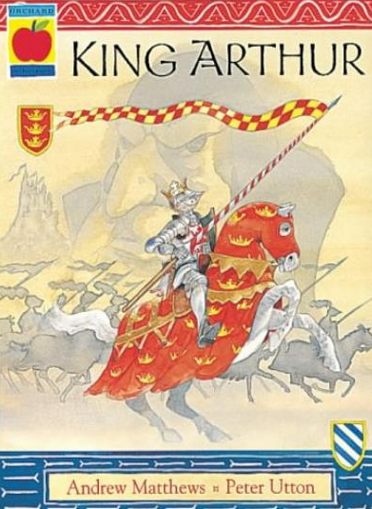
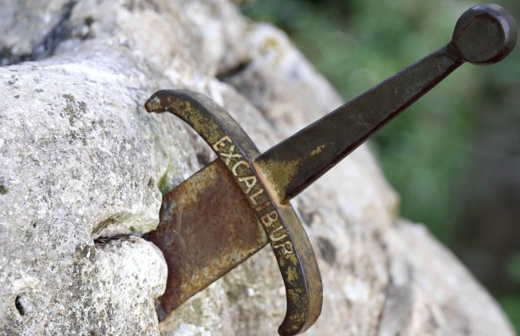
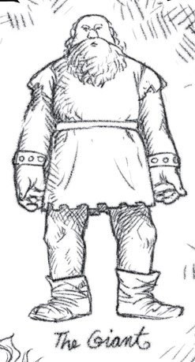
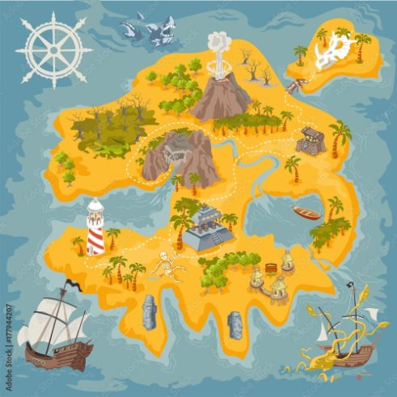
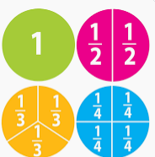
Year 2 Newsletter
Summer 1—2024/2025
Notices and Reminders
PE is on Friday. Please send you child to school in their PE kit and no earrings or watches.
Please bring their book and reading diary every day to school.
Key dates
Term begins - Tuesday 22nd April 2025
Bank holiday – Monday 5th May 2025
Last day of Summer 1 – Friday 23rd May 2025
Reading
This half term, the children will read 'King Arthur' retold by Andrew Matthews. This classic tale of adventure and enchantment begins with the magical appearance of
Merlin, and the birth of
Arthur, the boy who
became the High King of
Britain.
Writing
In writing, the children will learn to write a character description of the giant from Jack and the Beanstalk. They will then learn to write a persuasive leaflet about Pirate Island. The children will first learn the model text with actions and images, then innovate the text as a class before finally innovating themselves.
Maths
In maths, the children will begin by learning about parts, wholes, equal and unequal fractions. They will then learn how to recognise and find fractions, including halves, quarters and thirds. Next, the children will learn to tell the time. They will recap o'clock and half past before moving on to telling the time to quarter past and quarter to the hour.

Slide 2
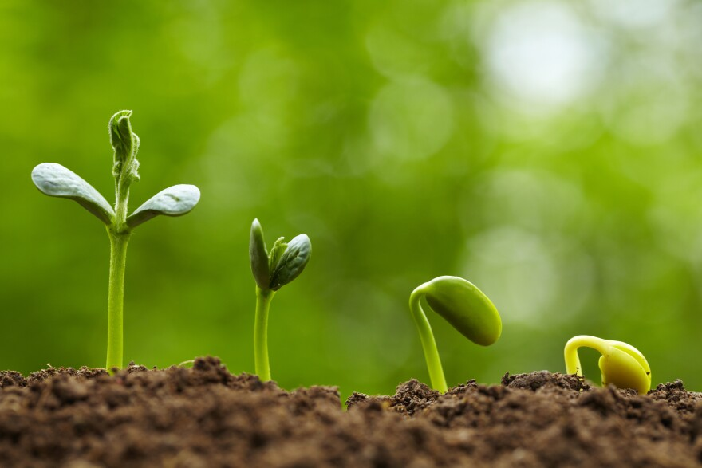
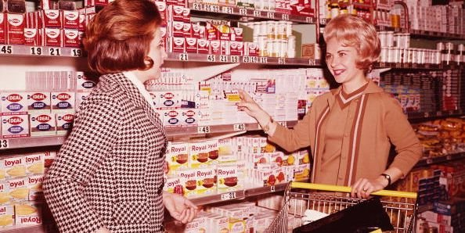
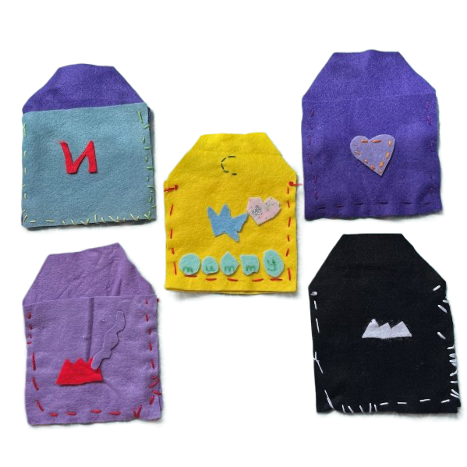
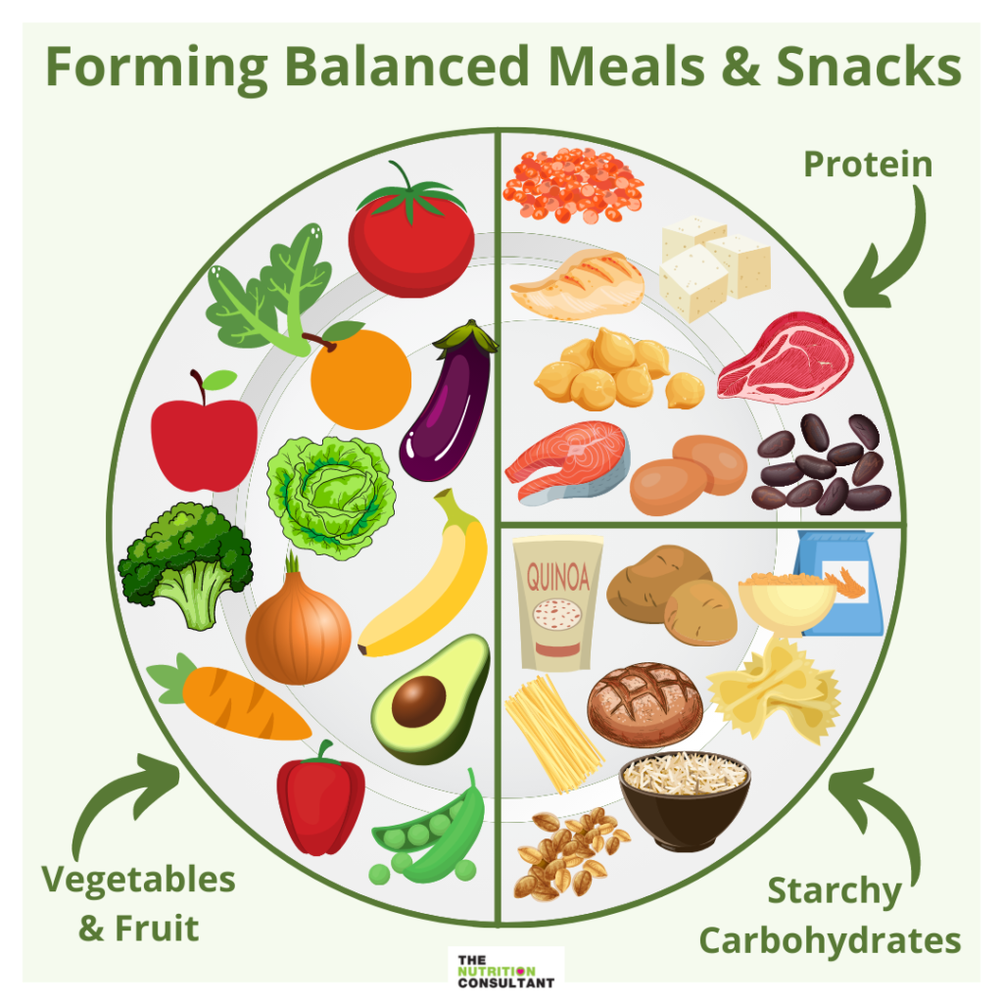
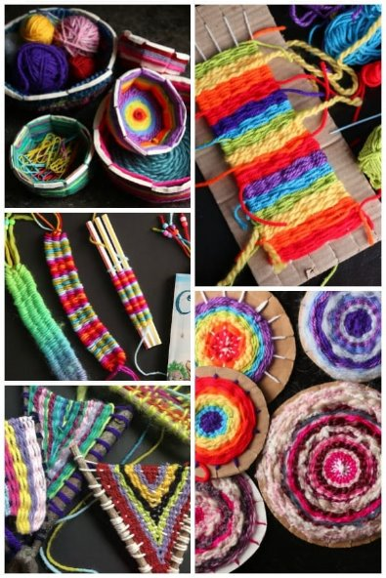
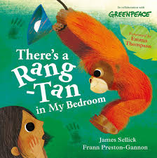
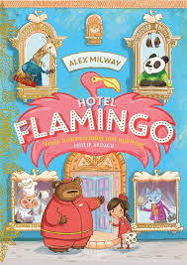
Science
In science, the children will be learning all about plants. They will learn about the parts of a plant, what a plant needs to grow and the lifecycle of a plant. They will also conduct a fair test to understand the best conditions to grow a seed and how it changes over time.
History
In history, the children will continue to build upon their understanding of chronology and past and present. They will study and consider how their own locality has changed since the 1950s and think about how this impacts their own lives. This unit will allow them to begin to understand why people did things in a certain way in the past and why this has changed over time.
DT
In DT, the children will be designing and making a pouch. They will be learning the basic skills of sewing, including how to sew the running stitch and how to add
decorations. They will also be
evaluating the effectiveness
of their pouch.
PE
In PE, the children will be learning athletics. They will learn how to master basic movements including running, jumping, throwing and catching. They will also develop their balance, agility and coordination.
Art
The children are going to explore the world of weaving inspired by Lenore Tawney. They will learn weaving techniques such as warping, wefting and pattern creation. Additionally, they will explore various materials and textures. The children will create their own woven masterpieces, drawing
inspiration from both
Lenore Tawney's legacy
and their own imagination.
PSHE
In PSHE, the children will be looking at what helps us to grow and stay healthy. They will look at what makes a healthy balanced diet and how it is important to eat a range of fresh fruit and vegetables. The children will also look at how exercise helps us to
keep healthy and how what
people need to keep their
minds healthy too.
Homework
Please listen to your child read at home at least 5 times a week and record in their reading diary. Once a child has read through their book 3 times they can change it on any day. Just like last term, it is their responsibility to remember to change their book.
Please do Times Table Rockstars 3 times per week for 10 minutes.
Suggested books for reading

