Slide 1
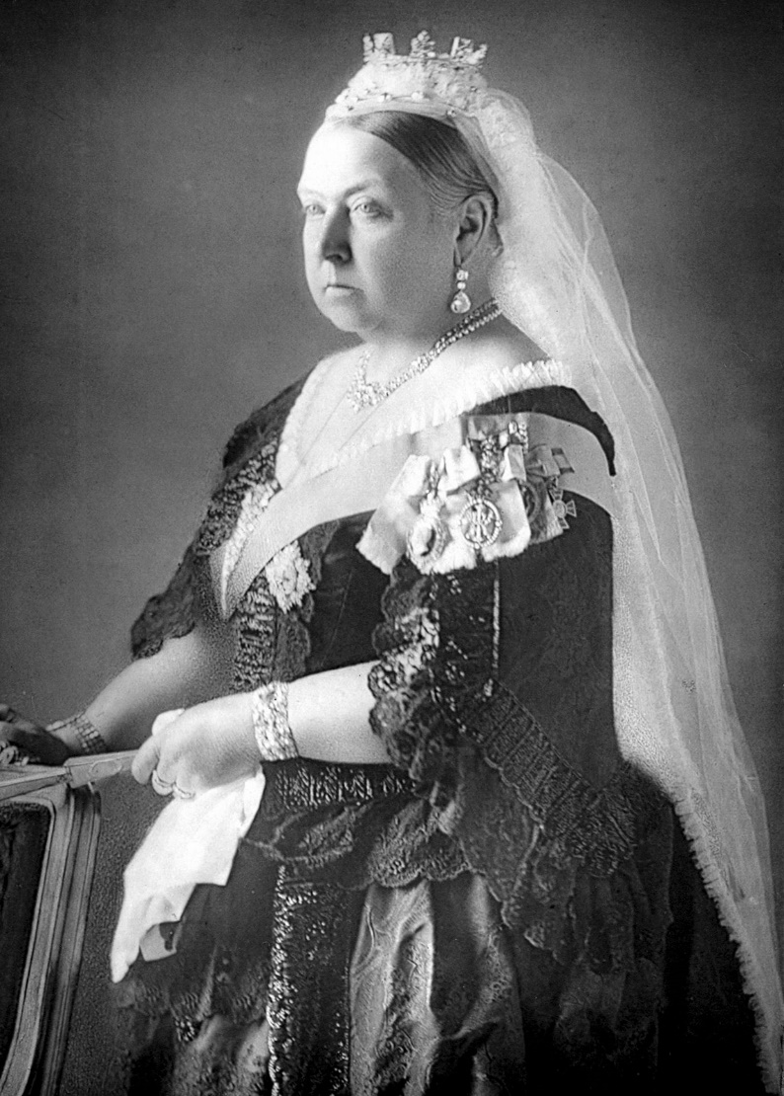
Meet the Teacher Welcome to Queen Victoria Class
Year 6 2022 - 2023

Slide 2
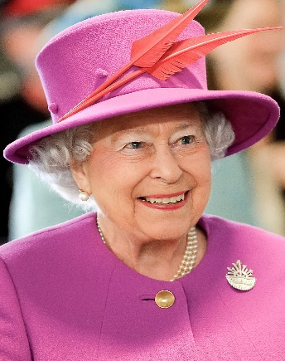
Teaching staff in Year 6
Queen Victoria Mrs Wilcox
LSA: Mrs Lawson and Mrs Hinton
Classroom will be downstairs
Queen Elizabeth Miss Young
LSA: Mrs Hooper and Mrs Gill
Classroom will be downstairs

Slide 3
Now that you are in Year 6, we are expecting you to be role models for the school!
High expectations in everything that we do “Always do the best you can”
Behaviour: We all follow The Grove Code
Active learners
Pupils showing resilience, independence and self organisation
Increased pace in lessons and working to deadlines
Working towards transition to Secondary school

Slide 4
Topic: Britain since 1930
We will be looking closely at the events associated with World War 2 including evacuation, the war effort, propaganda , the role of women, rationing, the Blitz and the Holocaust
We will then look at how Britain changes after the war ended. This will include events such as the coronation of Queen Elizabeth II and the formation of the NHS

Slide 5
Literacy Links
During English lessons in the first half term, we will be studying the book ‘Letters from the Lighthouse’ by Emma Carroll
It will be great if you could have your own copy of this book to use in lessons from the beginning of the Autumn Term

Slide 6
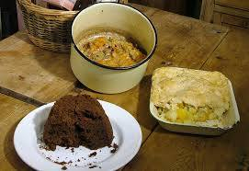
A “World War Two” experience… dressing up and food!
You will also need to bring in a packed lunch from home. We would like this to be as authentic as possible – we will give you more information on this, and all the day’s activities nearer the time!
In order to better understand what it was like to live in Britain during World War Two, we will be having a World War Two Day [Friday 17th September]
We would like you to dress up for the day. You will need to wear a costume/clothes that would have been worn by a child evacuee

Slide 7
Science .. Lots of practical investigations and enquiry questions
In DT, we will be making and designing working lighthouses. These will use a circuit that is controlled by a switch
Electricity
We will revise making series and parallel circuits
We will look at how we can alter the efficiency of components in a circuit such as bulbs, motors and buzzers

Slide 8
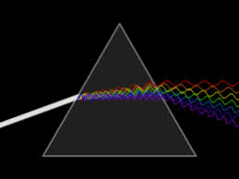
Science
Looking at Light
We will revise our knowledge of how we see
We will look at how light travels and reflects off different surfaces
We will investigate the colours of the spectrum
We look at the work of scientists who made discoveries linked to light

Slide 9
Things to think about!

Slide 10
Home learning
Reading x 3 minimum per week. Details regarding how this reading is to be recorded and assessed will follow in the Autumn term
Revision of Multiplication/division facts up to 12 x 12 [Use Times Tables Rock Stars regularly through week]
Weekly English and/or maths activity each week: the amount set per week will increase through the year as we prepare you for Secondary school
Half termly: menu of wider curriculum based activities~ 3 per half term to be completed to support and revise what we learn in class

Slide 11
Weekly reminders
PE: you will come to school wearing the correct PE kit on Tuesdays and Thursdays
PE kit is: Grove Logo House T-shirt, plain navy shorts or navy jogging bottoms. Plain navy sweatshirt [NO HOOD] You may wear the School tracksuit which can be bought from Brenda's. [No branded clothing please]
Earrings must be taken out or taped over on PE days by home not school
Weekly MFL~ French
Pencil Case (Next slide)
Daily “Golden Mile”
Water: daily in plastic bottle
Break time snack: fruit/vegetables only [No cereal bars, biscuits, sweets or nut based products please. We are a nut free school]

Slide 12
What will you need?
You MUST have your own SMALL clear plastic pencil case containing a:
handwriting pen with blue ink [not biro]
HB writing pencils
a small plain ruler
glue stick
scissors
green pen for improvements [this can be a biro] and colouring pencils and your own whiteboard pen
This pencil case must be able to fit into a drawer so the large sectioned ones from places like Smiggle will not be suitable. You are responsible for making sure that your pencil case is stocked each week with the things that you need

Slide 13
Communication
If there are any issues during the year, please speak to the me at the gate or send me a message through Seesaw.

Slide 14
It’s time to relax!
You have worked so hard over the past few weeks, it is time to relax and enjoy your holiday. You deserve a very long, enjoyable break filled with lots of fun!
You have absolutely nothing to worry about for next year. We will take everything in little steps and we will ensure you have all the support you need to do your very best. It is your last year at The Grove and we are going to make it the best one yet! I cannot wait to see you all in September.

