Slide 1
Meet the Teacher 2022/23

Slide 2
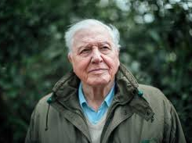
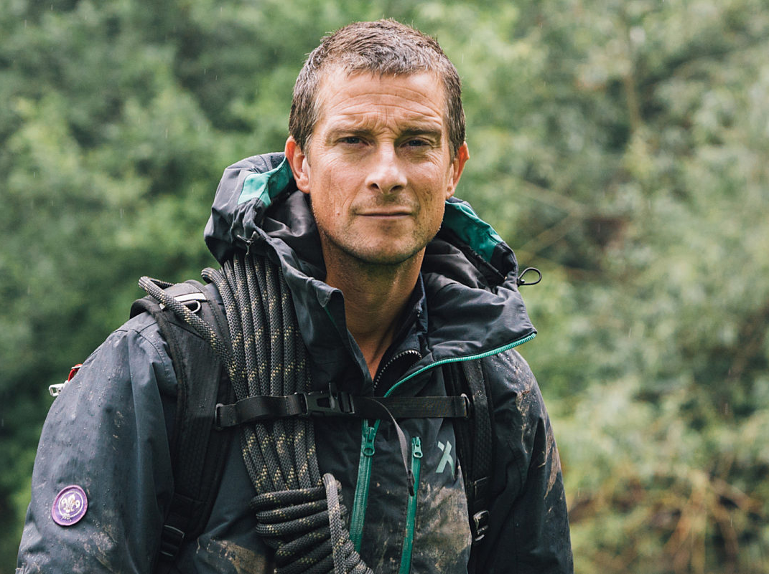
Classes
David Attenborough
Teacher – Miss Hogston
Bear Grylls –
Teachers - Mrs Rees and Mrs Pownall

Slide 3
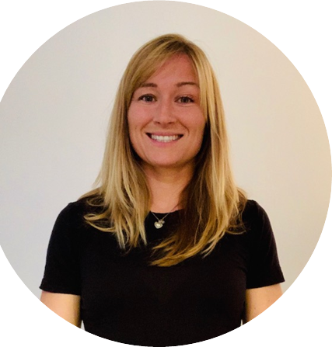
All about me
Hello everyone,
I already know many of you from out time in Year 4 together. I am really looking forward to having you all in my class in September.
My favourite subjects to teach are English, History and PE. I enjoy reading stories, especially ones that make children laugh and I love making learning come to life.
I am look forward to seeing you after the summer holidays. Until then, take care, keep learning and stay active!
My Favourites…
Colour – Purple
Season – Summer
Food – Strawberries (and chocolate!)
Drink – Ribena (only on special occasions ☺)
Hobbies – CrossFit, reading and running
Book – Harry Potter and the Goblet of Fire
Film – Patch Adams
Game – Dobble

Slide 4
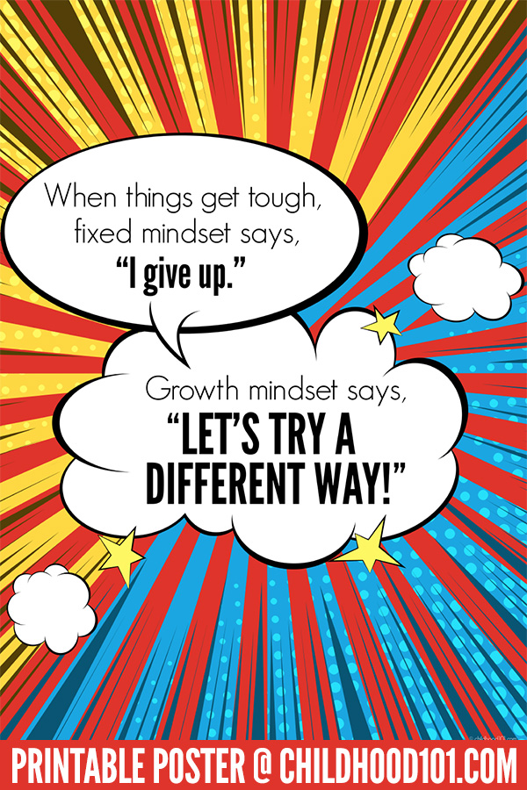
David Attenborough Class
In David Attenborough Class we are…
Kind
Helpful
Active learners
Hard-working
We have…
A growth mind-set
A love for challenge
And importantly we have fun

Slide 5
The School Day
8.50 – 9.00 Morning task
9 – 9.30 Guided Reading
9.30 – 10.30 English
10.30 – 10.45 Break Time
10.45 – 10.55 Golden Mile
11 – 12 Maths
12 – 12.20 Class Reading
12.20 – 1.20 Lunchtime
1.20 – 1.40 Assembly
1.40 – 3.00 Topic/Science/Art/PE
3.00 – 3.20 Tidy up for home/Reading
This is how our days will look, they will change slightly depending on the day but will mostly follow this time table.

Slide 6
Year 5 expectations
Behaviour: We all follow The Grove Code.
Learning: We are active, independent and organised learners and we are resilient in our approach.
Organisation: In Year 5 there is an increased pace in lessons and we learn to work to deadlines as well as organise our time and our equipment.
Values: As a school, we value high aspirations, resilience and diversity.

Slide 7
Overview of English and maths
Term |  | Maths | English
Autumn Term Topics: Vikings and Anglo Saxons Forces Space | Autumn 1 | Place value Addition and subtraction | Text | The Strange Case of Origami Yoda Odd and the Frost Giants
 |  |  | Outcomes | Letters, Dialogue, Character/ Setting description, Action, Narrative recount, Balanced argument VIPERS, Comprehension skills
 | Autumn 2 | Multiplication and division Graphs Area and perimeter | Text | Curiosity: The Mars Rover (Markus Motum) Hidden Figures
 |  |  | Outcomes | Project proposal, Information writing, Explanation writing, News Report, Biography VIPERS, Comprehension skills

Slide 8
Autumn Term Topic

Slide 9
Subject focus for the year
English
Writing: quality presentation and joined, handwriting
Accurate use of basic sentence punctuation
Re reading for meaning and clarity
Spelling: accurate use of dictionary to check errors
Reading~ “promoting a love of reading”
Regular reading at home to compliment group/individual reading situations within school
Maths
Mastery Approach
STEM sentences
Explaining reasoning to show knowledge
Mental and written arithmetic
All tables to 12x recalled accurately and fluently

Slide 10
Home learning
Weekly:
Reading x 5 [signed on Seesaw]
Multiplication/division facts up to 12 x 12 [TTRS X 5]
Alternate weekly:
English or maths activity – set Friday due back on Thursday
Half termly
Wider curriculum based activities

Slide 11
Reminders
PE – Tuesday and Thursday (Kit in school for both these days).
French – Weekly on a Monday.
Water Bottle – Needs to be in school everyday.
Stationery – Children must bring:
small, basic pencil case with pencils, a rubber, a 30 cm ruler, a blue handwriting pen, glue stick, white board pen and colouring pencils.
School day starts at 08:45 - Please ensure children are lined up ready to start the day on time. When the whistle blows, parents should make their way off of the playground.

Slide 12
Visits, visitors and residential
Viking Day: We will have a whole day dedicated to the Vikings, you will come into school in a Viking costume and have a day packed with Viking activities.
Greek Week: During Greek week we will make and evaluate food, have a mini Greek Olympics, dress up as a Greek day and much more!
Home and Away: Summer term work focuses on our visit to Selborne to compare the settlement, local environment and river studies. We then compare this as we study how Frimley developed as a settlement. We hope to run a trip to Selbourne to study the river and village.

Slide 13
Communication
Staff will send out Seesaw messages individually or to the year group as appropriate. We will endeavour to reply to your messages as soon as we are able to during the day.
Drop off/pick up: we will be in the playground.
Home learning will be recorded on Seesaw.
Any issues involving your child, please speak to the class teacher in the first instance then Mrs Griffiths as Key Stage 2 leader, before approaching Mrs Wicksey.

