Slide 1
Meet the Teacher 2022/23

Slide 2
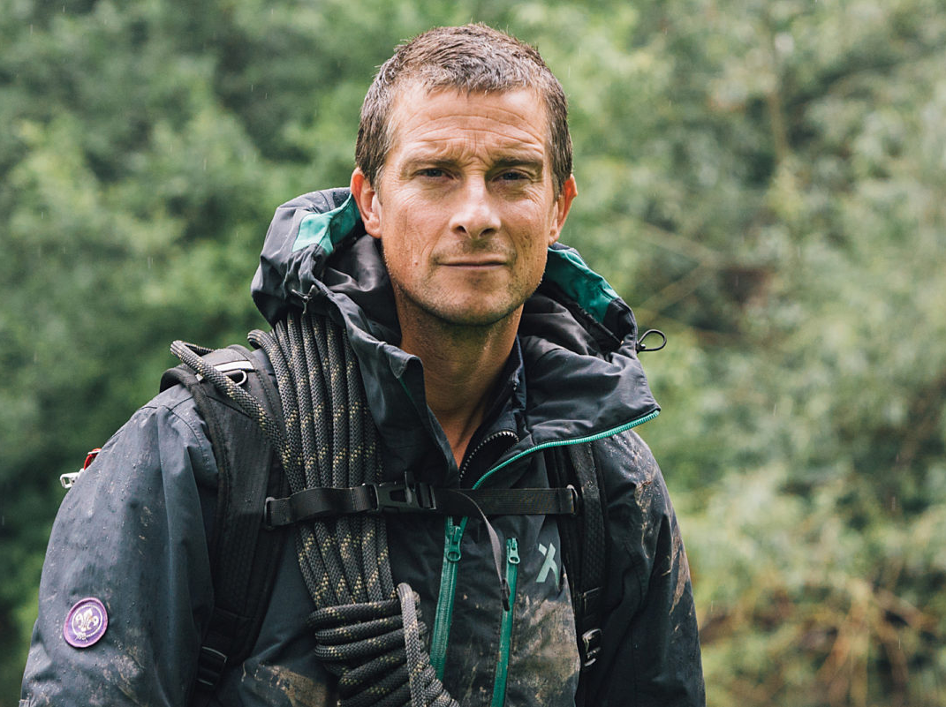
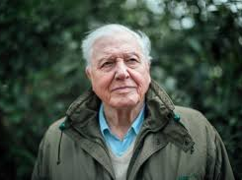
Classes
Bear Grylls –
Teachers - Mrs Rees and Mrs Pownall
David Attenborough
Teacher – Miss Hogston

Slide 3
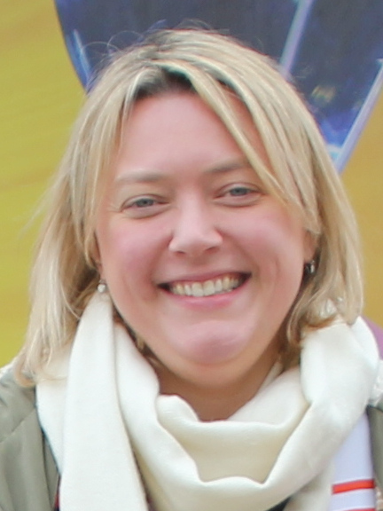
Welcome from mrs rees
Hello to the future Bear Grylls class,
My name is Mrs Rees and I will be teaching Bear Grylls Class Mrs Pownall next year. I will be teaching the class on Monday, Tuesday and Wednesday and Mrs Pownall on Thursday and Friday. This will be my fifth year teaching at The Grove and I am thoroughly enjoying it.
My favourite subjects to teach are English, history and PSHE. I love books and, when I'm not teaching, I love to read. My favourite stories are mysteries, though I love to read lots of different types of books. I also love to swim and go for walks with my dog.
Being in Year 5 is a fantastic experience and there are lots of exciting topics to study this year. Looking forward to seeing you again after a relaxing summer holiday!

Slide 4
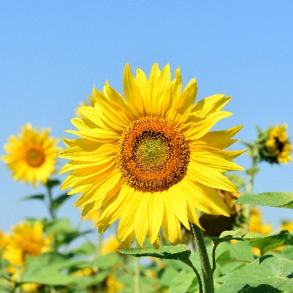
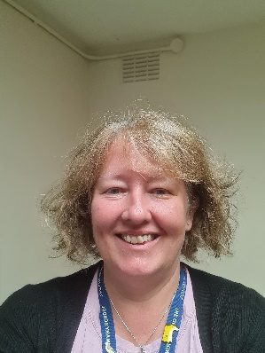
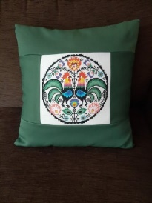
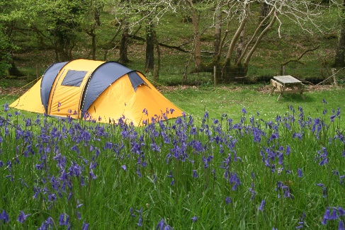
Hello from Mrs Pownall!
I will be your class teacher on Thursday and Friday You will also see me in school on Mondays.
I have two children: Isaac who is 14 and Tom who is 10.
I love:
Reading. My favorite authors include Michael Morpurgo, Philip Pullman and Maz Evans
Camping with my family and friends
Cross Stitch and sewing

Slide 5
BEAR GRYLLS Class
In Bear Grylls Class we are…
Kind
Helpful
Active learners
Hard-working
We have…
A growth mind-set
A love for challenge
And importantly we have fun

Slide 6
The School Day
8.50 – 9.00 Morning task
9 – 9.30 Guided Reading
9.30 – 10.30 English
10.30 – 10.45 Break Time
10.45 – 10.55 Golden Mile
11 – 12 Maths
12 – 12.20 Class Reading
12.20 – 1.20 Lunchtime
1.20 – 1.40 Assembly
1.40 – 3.00 Topic/Science/Art/PE
3.00 – 3.20 Tidy up for home/Reading
This is how our days will look, they will change slightly depending on the day but will mostly follow this time table.

Slide 7
What you will need
You MUST have your own SMALL clear plastic pencil case containing a:
handwriting pen with blue ink [not biro]
HB writing pencils
a small plain ruler
glue stick
scissors
green pen for improvements [this can be a biro] and colouring pencils and your own whiteboard pen
This pencil case must be able to fit into a drawer so the large sectioned ones from places like Smiggle will not be suitable. You are responsible for making sure that your pencil case is stocked each week with the things that you need

Slide 8
Year 5 expectations
Behaviour: We all follow The Grove Code.
Learning: We are active, independent and organised learners and we are resilient in our approach.
Organisation: In Year 5 there is an increased pace in lessons and we learn to work to deadlines as well as organise our time and our equipment.
Values: As a school, we value high aspirations, resilience and diversity.

Slide 9
Overview of English and maths
Term |  | Maths | English
Autumn Term Topics: Vikings and Anglo Saxons Forces Space | Autumn 1 | Place value Addition and subtraction | Text | The Strange Case of Origami Yoda Odd and the Frost Giants
 |  |  | Outcomes | Letters, Dialogue, Character/ Setting description, Action, Narrative recount, Balanced argument VIPERS, Comprehension skills
 | Autumn 2 | Multiplication and division Graphs Area and perimeter | Text | Curiosity: The Mars Rover (Markus Motum) Hidden Figures
 |  |  | Outcomes | Project proposal, Information writing, Explanation writing, News Report, Biography VIPERS, Comprehension skills

Slide 10
Autumn Term Topic

Slide 11
Subject focus for the year
English
Writing: quality presentation and joined, handwriting
Accurate use of basic sentence punctuation
Re reading for meaning and clarity
Spelling: accurate use of dictionary to check errors
Reading~ “promoting a love of reading”
Regular reading at home to compliment group/individual reading situations within school
Maths
Mastery Approach
STEM sentences
Explaining reasoning to show knowledge
Mental and written arithmetic
All tables to 12x recalled accurately and fluently

Slide 12
Home learning
Weekly:
Reading x 5 [signed on Seesaw]
Multiplication/division facts up to 12 x 12 [TTRS X 5]
Alternate weekly:
English or maths activity – set Friday due back on Thursday
Half termly
Wider curriculum based activities

Slide 13
Reminders
PE – Tuesday and Thursday (Kit school for both these days).
French – Weekly on a Monday.
Water Bottle – Needs to be in school everyday.
Stationery – Children must bring:
small, basic pencil case with pencils, a rubber, a 30 cm ruler, a blue handwriting pen, glue stick, white board pen and colouring pencils.
School day starts at 08:45 - Please ensure children are lined up ready to start the day on time. When the whistle blows, parents should make their way off of the playground.

Slide 14
Visits, visitors and residential
Viking Day: We will have a whole day dedicated to the Vikings, you will come into school in a Viking costume and have a day packed with Viking activities.
Greek Week: During Greek week we will make and evaluate food, have a mini Greek Olympics, dress up as a Greek day and much more!
Home and Away: Summer term work focuses on our visit to Selborne to compare the settlement, local environment and river studies. We then compare this as we study how Frimley developed as a settlement. We hope to run a trip to Selbourne to study the river and village.

Slide 15
Communication
Staff will send out Seesaw messages individually or to the year group as appropriate. We will endeavour to reply to your messages as soon as we are able to during the day.
Drop off/pick up: we will be in the playground.
Home learning will be recorded on Seesaw.
Any issues involving your child, please speak to the class teacher in the first instance then Mrs Griffiths as Key Stage 2 leader, before approaching Mrs Wicksey.

