Slide 1
Meet the Teacher 2022/23

Slide 2
WELCOME TO
Year 4

Slide 3
Year 4 Classes
Lewis Carroll
Teacher – Miss Ramsbottom
Roald Dahl
Teacher - Miss Partridge
Your new class!!

Slide 4
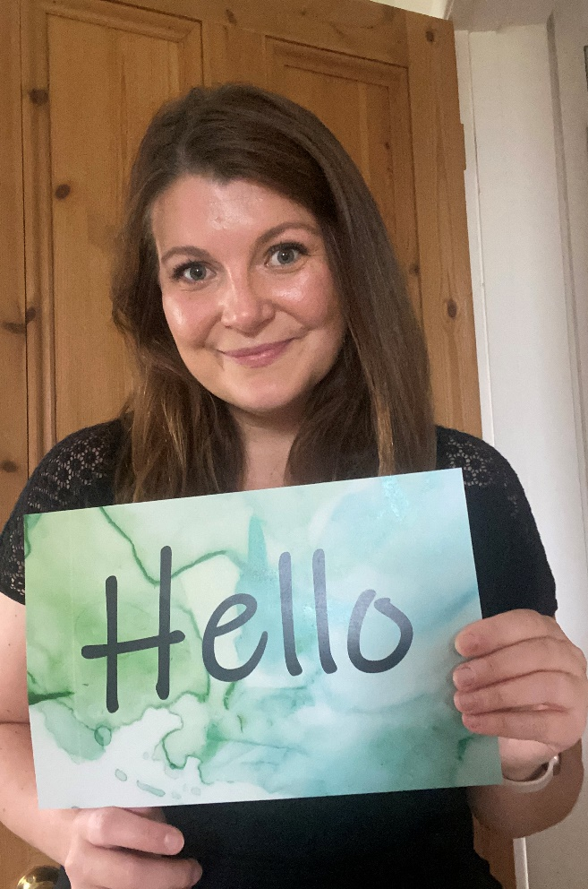
All about me
My name is Miss Ramsbottom. This year is my first year teaching at The Grove and I am incredibly excited.
I love art so you can look forward to lots of creative fun next year.
I also love plants so you can expect to see touches of greenery in our classroom – see if you can spot the plants on our first day in September.
I cannot wait to teach all the brilliant topics this year, in particular, the Egyptians (it was my favourite when I was at school!)
My Favourites…
Colour – Blue
Season – Summer
Food – Roast Dinner with A LOT of gravy
Drink – Blackcurrant squash
Hobby – Cooking
Book – The Explorer by Katherine Rundell
Film – Fly Away Home
Game – Dobble

Slide 5
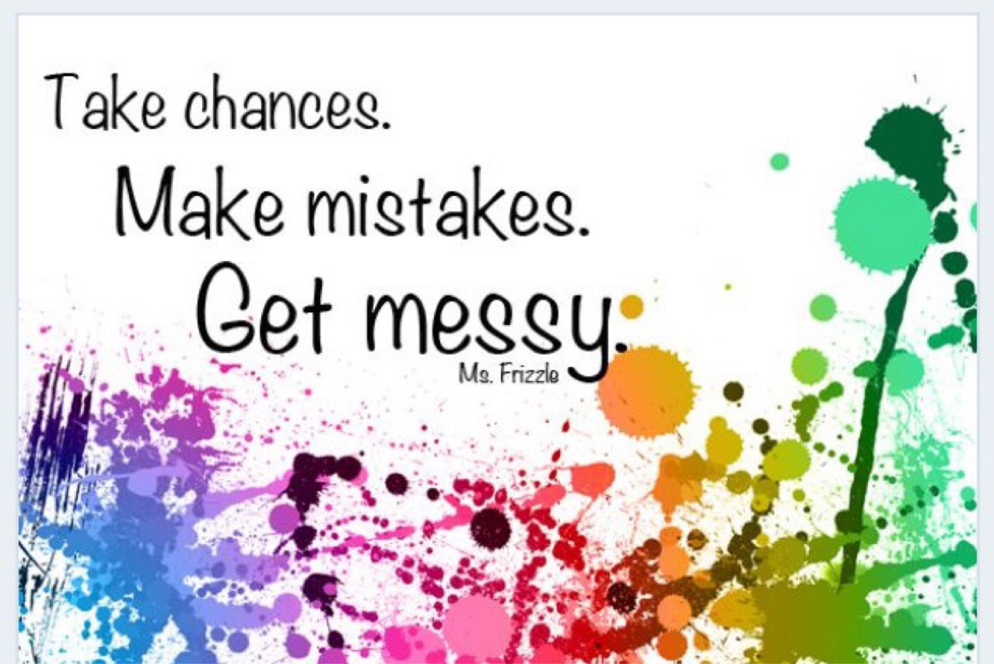
Lewis Carroll Class
In Lewis Carroll Class we are…
Kind
Respectful
Helpful
Active learners
Hard-working
We have…
A growth mind-set
A love for challenge
FUN!

Slide 6
The School Day
8.45 – 9.00 Morning task/Handwriting
9 – 9.30 Guided Reading
9.30 – 10.30 English
10.30 – 10.45 Break Time
10.45 – 11.45 Maths
11.45 – 12.00 Golden Mile 12.00 – 12.20 Times Tables
12.20 – 1.20 Lunch
1.20 – 1.30 Assembly or Quiet Reading
1.30 – 3.10 Topic/Science/Art/PE
3.10 – 3.20 Tidy up for home time
This is how our days will probably look, they will change slightly depending on the day but will mostly follow this time table.

Slide 7
Year 4 expectations
Behaviour: We all follow The Grove Code
Active learners
Developing resilience in approaches to learning
Building independence and self organisation
Increased pace in lessons
High expectations in everything that we do “Always do the best you can”

Slide 8
Overview of English and maths
Term |  | Maths | Writing |  | Reading
Autumn Term Topic: Egyptians Science: Sound Electricity | 1 | Place Value Addition and Subtraction | Text | Cinderella of the Nile by Beverley Naidoo and Marian Vafaeian ‘Jabberwocky’ by Lewis Carroll | The Lost Spell by Robert Macfarlane and Jackie Morris
 |  |  | Outcomes | News report, diary entry, character description, advert, traditional tale Performing and writing poetry
 | 2 | Length and Perimeter Multiplication and Division | Text | The Story of Tutankhamun by Patricia Cleveland-Peck | How Does a Lighthouse Work? By Roman Belyaev
 |  |  | Outcomes | Non-chronological report, instructions, character descriptions, diary entry, newspaper report, biography

Slide 9
Autumn Term Topic

Slide 10
Home learning
Weekly:
Reading x 3 minimum [signed in diary]
Times Table Rockstars - Multiplication/division facts up to 12 x 12
Either a English or maths activity (to alternate weekly)
Half termly:
Wider curriculum based activities

Slide 11
Times Tables
Year 4 complete the Multiplication Check in June.
By then, all children need to be fluent with their times tables up to 12 x 12
It is really important to practice times tables at home all through the year, and we will be doing daily times table practice in school as well.

Slide 12
Reminders
PE – PE Kit needs to be worn on PE days. Please ensure that for PE your child is wearing their Grove PE t-shirt, navy jogging bottoms or shorts, and a navy sweatshirt. We will have PE on a Monday and Thursday.
French – Year 4 will continue to have French lessons weekly.
Water Bottle – Needs to be in school everyday
School day starts at 8:45am - You need to be lined up ready for the school day to start then.

Slide 13
Equipment
Children should bring in a small, basic pencil case with…
A pencil
A handwriting pen
A rubber
A ruler
A glue stick,
A sharpener
A whiteboard pen
A green pen
Some colouring pencils

Slide 14
Visits, visitors and residential
Egyptian Day – December 2021 (Date TBC) – We will have a whole day in school where we enjoy lots of Egyptian themed activities, we may even get to taste some Egyptian foods!
Ufton Court – 13th - 15th March 2022 – We are so luck in Year 4 that we get to go on a three day residential! In Spring Term, we will be heading to Ufton Court for three whole days of Roman fun.

Slide 15
Communication
Any questions, send on Seesaw – I will reply as soon as possible.
Drop off/pick up: I will be in the playground.
Any issues involving your child, please speak to the class teacher in the first instance then Mrs Griffiths as Key Stage 2 leader, before approaching Mrs Wicksey.

Slide 16
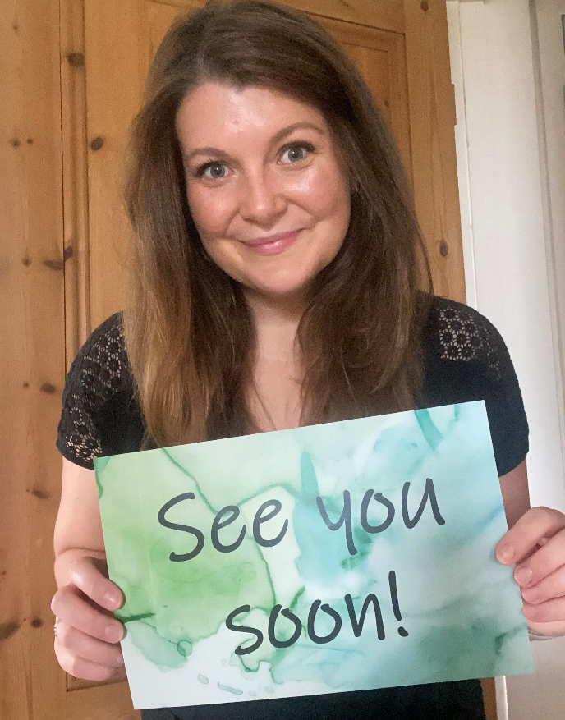
I hope you have a fabulous summer and I can’t wait to see you all in September!!!

