Slide 1
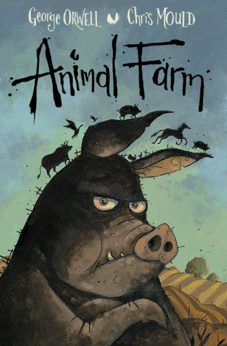
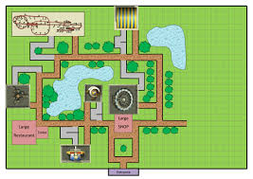
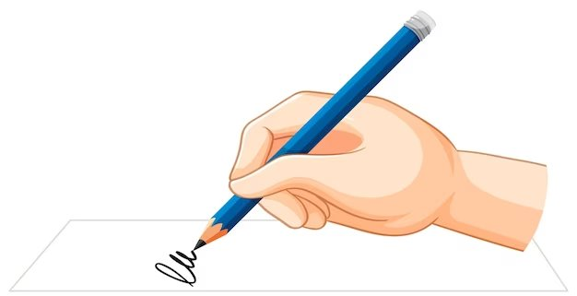
Year 6 Newsletter
Summer 1—2024/2025
Notices and Reminders
-Please ensure pencil cases are fully stocked.
-PE day will continue to be on a Monday.
-Homework will continue to be set on Fridays and due in the following Friday.
Key dates
SATs Week and SATs Breakfast
Mon 12th May – Thurs 15th May
Sports Day
Friday 4th July
Red Carpet Day
Friday 11th July
Y6 Production
Wednesday 16th July
Thursday 17th July
The Quays
Friday 18th July
Shirt Signing
Tuesday 22nd July
Reading
During this half term, the children will finish reading 'Mortal Engines' by Philip Reeve. We will then move onto reading 'Animal Farm' by George Orwell. During the reading lessons,
the children will concentrate on building their reading stamina, prosody and
comprehension skills. The children
will learn how to answer retrieval,
inference, word choice
sequencing and summary
questions.
Writing
During this half term, the children will have opportunities to build independence in their writing. They will spend more time considering the audience and purpose of their writing and adjust the tone and formality of their writing accordingly. Children will be writing for a wide range of purposes including to entertain, inform, describe and persuade.
Maths
This half term, children will revisit prior learning over a range of topics to build their confidence and independence in readiness for their SATs in May.
Additionally, they will be applying their knowledge to project work in which they will draw from multiple
mathematical topics,
work in small teams
and achieve a set goal.

Slide 2
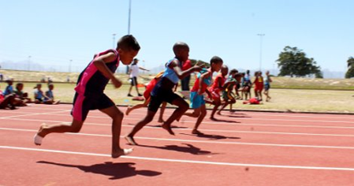
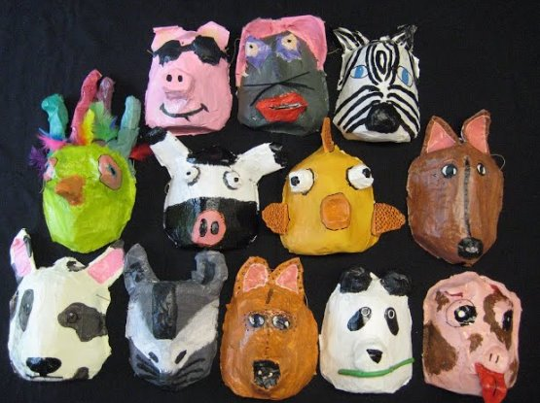
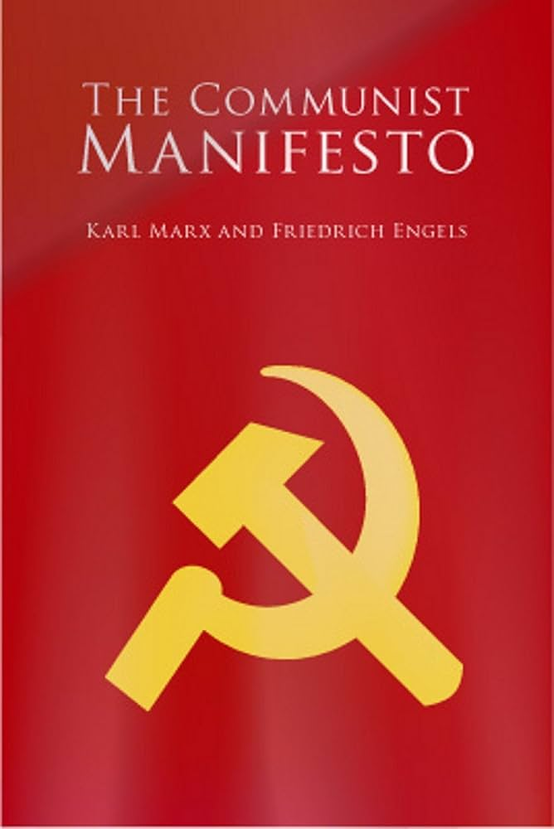
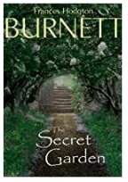
Science
Through our science lessons this term, the children will be learning about light. They will identify how light travels, explore reflection and refraction, as well as discover how shadows
are formed. The children
will also learn how the
brain helps us to see.
PE
This half term, the children will be focussing on athletics, including running, jumping and throwing. They will begin by developing their speed and agility. They will then move onto jumps and throws. Finally, they will put these skills together into a competition.
Art
This half term, the children will be learning how to design and make paper mâché masks. They will begin by learning about the types of masks used around the world and comment on the similarities and differences, which media was used and what the purpose could be. When designing and making, the children will take inspiration from our reading book, Animal Farm.
PSHE
In PSHE this half term, the children will be focusing on 'How friendships change as we grow?' They will look at what makes a positive, healthy relationship and how to recognise an unhealthy one. Finally, we will look at why some friendships may change as we grow and how we can deal with these changes.
French
In French this half term, the children will learn some key facts from the history of the ancient and modern Olympic games in French. The children will learn to name 10 Olympic sports and how to conjugate the 1st and 3rd person form of the verb faire. In addition, the children will attempt to use the negative correctly.
History
This half term, the children will be learning about the Russian Revolution. They will explore capitalism and communism, and learn about key people such as Karl Marx,
Tsar Nicholas II, Lenin and
Stalin. They will explore
the impact that propaganda,
and these leaders, had on
people around the world.
Suggested books for reading

