Slide 1
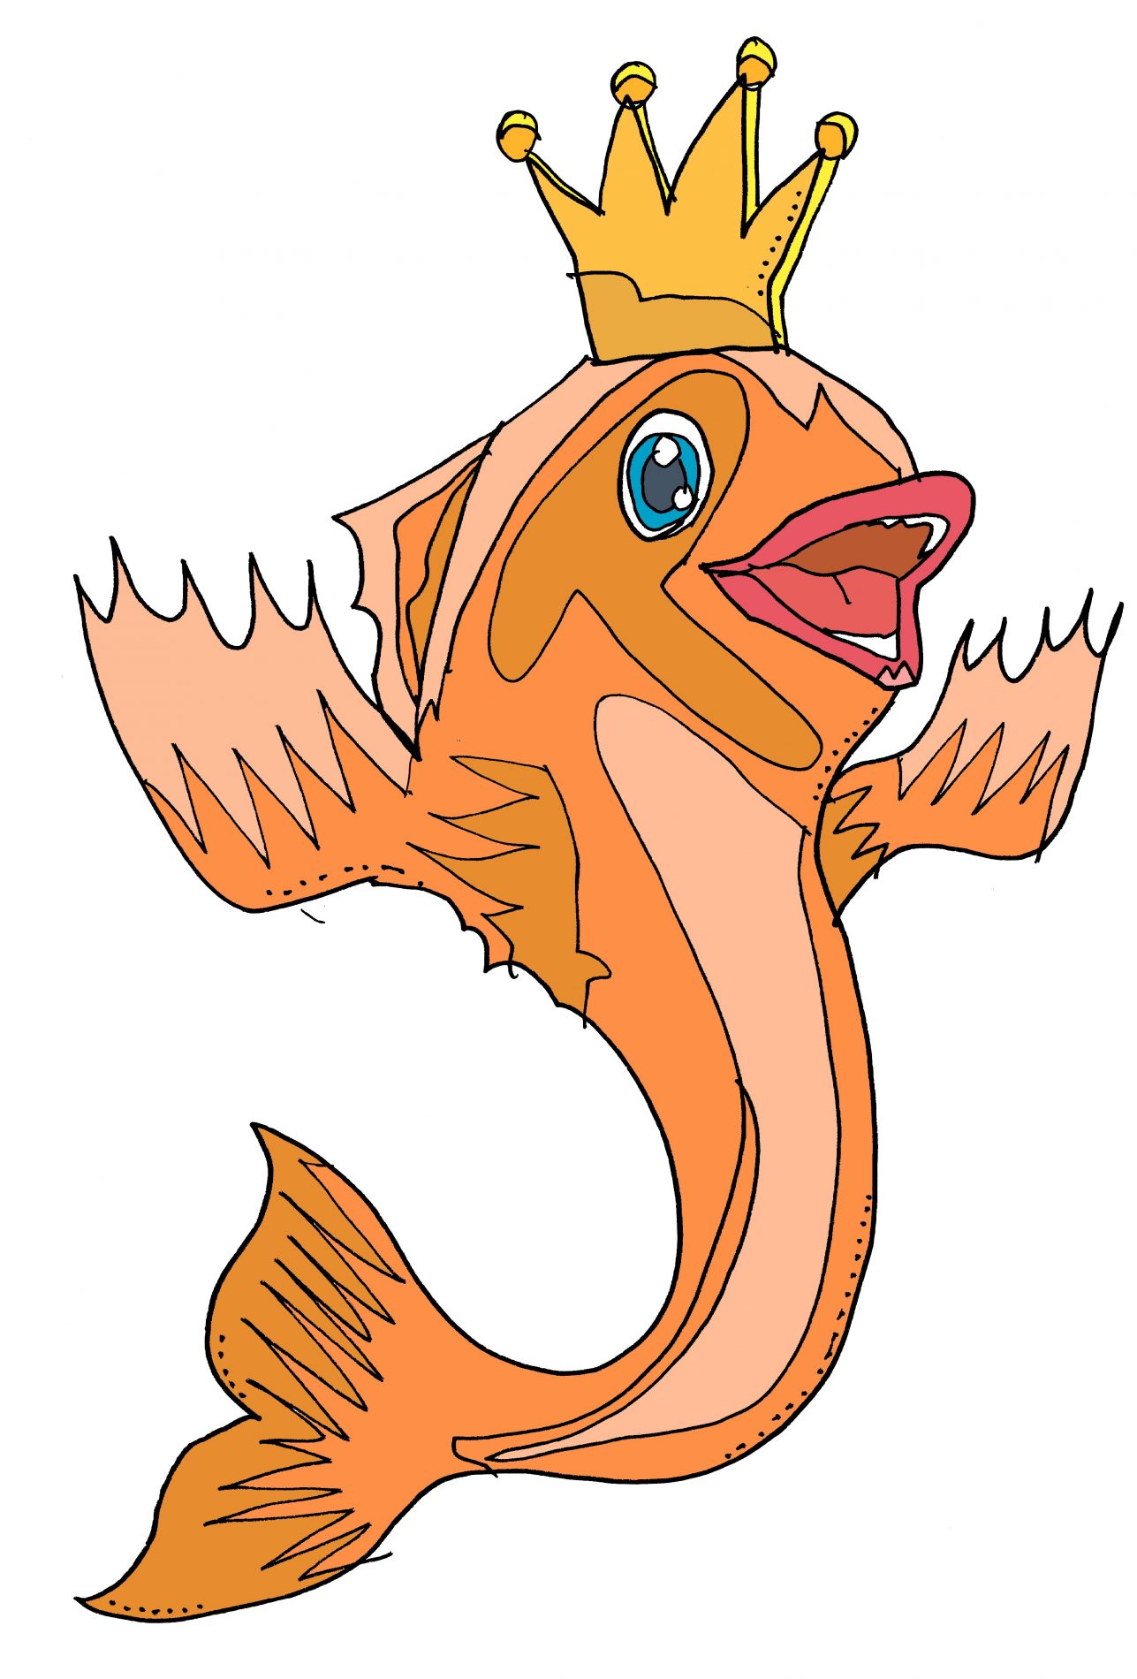
Year 3 Newsletter
Summer 1—2024/2025
Notices and Reminders
Key dates
Friday 9th May – Beatrix Potter trip to the Quays
PE days are every Wednesday.
Daily homework is TTRS and reading to an adult. Optional tasks relating to the wider curriculum have been sent home. Please let us know if you need another copy.
Reading
This half term, the children will be
reading 'The Wild Robot' by Peter
Brown. The story follows Roz, a
robot survivor of a shipwreck, who
is stranded on a deserted island.
Roz learns to survive on this island and build relationships with the creatures living there.
During reading lessons, the children will continue to listen to modelled reading, read aloud to the class and independently answer comprehension style questions to support understanding.
Writing
In spelling lessons this half term, the
children will be learning how to
syllabify 3 syllable words to support
them with their spelling. In writing lessons, the children will continue to improve their writing by creating coherent stories based on The King of the Fishes. They will learn how to use speech punctuation and descriptive devices and will also work on including precise vocabulary to add interest to their writing. The children will continue to improve their grammar and apply this in their own writing.
Maths
This half term, the children will continue to practise their multiplication tables focusing on the 3 and 6 times tables. They will also begin learning about money and convert between pounds and pence before learning to add and subtract amounts of money.
The children will then move on to learn about time. They will learn how to accurately read time on a digital clock and then work on solving problems with time.

Slide 2
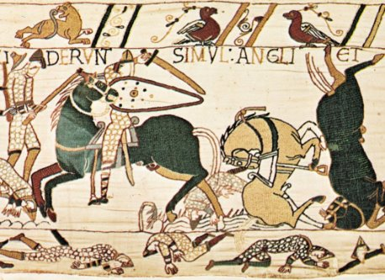
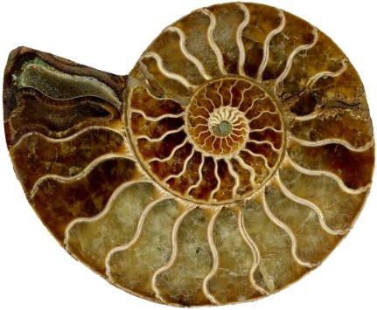
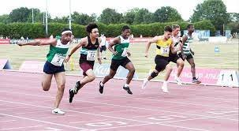
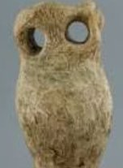
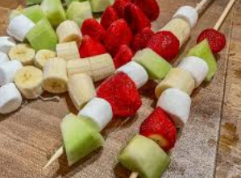
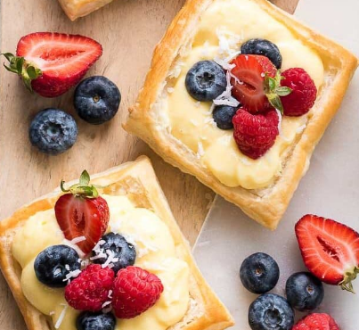
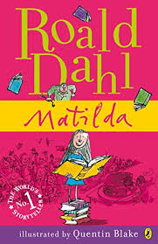
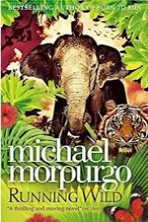
Science
This half term, the children will be learning about rocks. They will compare and group together different kinds of rocks based on their appearance and simple physical properties. They will then learn about how fossils are formed and investigate
soil so that they recognise
that soils are made from
rocks and organic matter.
History
This half term, the children will be
learning about the Norman
Conquest and how it changed Britain. Within this unit, they will find out who the Vikings and Anglo-Saxons were, followed by considering what life was like when King Alfred ruled. The children will then learn about the rulers during the Norman Conquest, including the two main battles and they will study the Bayeux Tapestry.
Art
This half term, the children will be learning about the English sculpture artist Henry Moore. They will experiment moulding and joining pieces of clay before planning, creating and painting a clay sculpture using
Moore's owl as a model.
They will then evaluate their
artwork in comparison to
Moore's owl.
PE
This half term, the children will be
developing their strength and flexibility in athletics. This includes a focus on the differences between running and sprinting. They will then apply these techniques through relays. Towards the end of term, the children will learn different throwing techniques and jumps. They will also learn which techniques are best suited to different tasks.
DT
This half term, the children will be focusing on food technology. They will be learning about where our food comes from. The children will start by making fruit skewers before moving on to make either savoury or fruit tarts. Where possible, they will be using local and seasonal produce to do this.
PSHE
This half term, the children will be learning about hygiene and identifying ways in which they can have good hygiene. They will then look at oral hygiene and how to prevent plaque and tooth decay. Later in the term, the children will learn about hazards and dangers and how accidents can be
avoided.
French
This half term, the children will consolidate their learning of the ten animals that they have already learnt. They will focus on the indefinite article/determiner and then they will begin to use these animals in a short sentence.
Suggested books for reading

