Slide 1
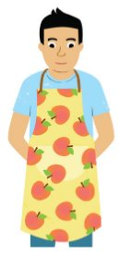
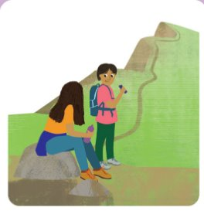
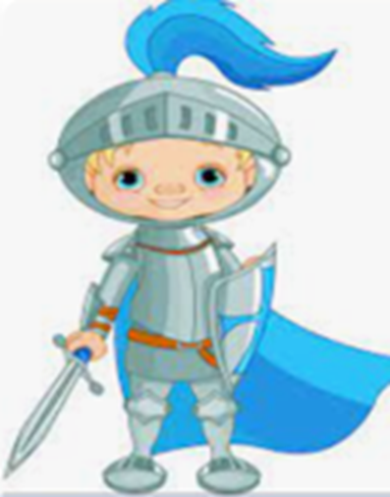
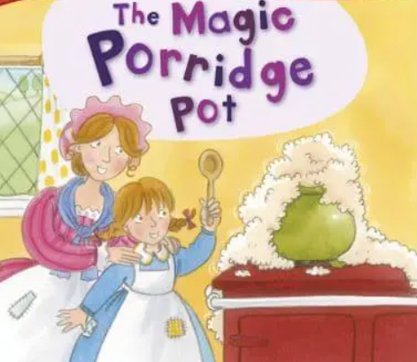
Year 1 Newsletter
Spring 1 —2024/2025
Delete and insert academy logo
Key Dates
Monday 6th January – Term begins
Friday 17th January – Inset day
Monday 17th February – Friday 21st February – Half Term
. Notices and Reminders
PE will continue to be on a Tuesday. Please remember to send children in full PE kit on this day.
Please provide your child with a bottle - it must contain water.
Please remember to read with your children 5 times a week and record this in their diary.
A general reminder we can not give out new books until the previous one is returned.
Phonics
The children are learning alternative spellings from previously taught sounds:
/ai/ <a>, <ey>, <ea>, <eigh>, /ar/ <a> /ee/ <e>, <I>, <y>, /ur/ <or>, /ur/ <ear>, /oo/ <ou>, /oa/ <ou>, /ee/ <ie>, /v/ <ve>, /i/ <y> ,/air/ <are>,
<ere> , <ear>, /ch/ <tch>
The children are learning to read the harder to read and spell words:
here, sugar, friend, because.
Writing
This half term in writing, the children will be learning some stories by heart. They will then write them using their phonic knowledge before undertaking some simple editing.
The texts the children will learn are:
Brave Knights
The Magic Porridge Pot
Maths
This half term in maths, the children are learning about place value with numbers up to 20 and addition and subtraction.
They will use resources such as counters, tens frames and part-whole models to support their understanding of these concepts.

Slide 2
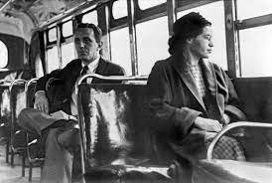
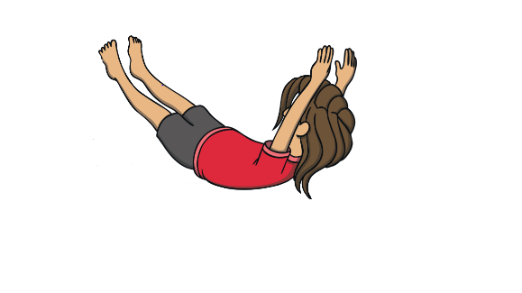
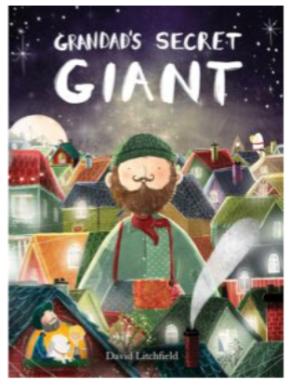
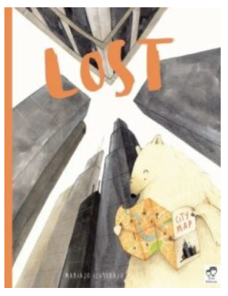
Science
In science the children will be learning about animals. They will be learning how to classify animals into their given groups. They will spend time identifying and naming animals that are carnivore, herbivores and omnivores. They will learn about us as humans. They will learn the different body parts and how our five senses link to these body parts.
History
In history the children will be learning the answer to the big question - How did Rosa Parks help change society? The children will be learning what history is, what chronology is and will be looking at artefacts from the past. The children will learn about incidents in both the USA and the UK and compare them.
Art
In art this term, the children will be learning about primary and secondary colours and the colour wheel. They will be looking at surrealism and two surrealist Artist Joan Miro and Lenora Carrington and replicating a piece of artwork by one of these artists.
PE
In PE this half term, the children will be learning how to roll in different ways. They will learn to do a front and back support and how to jump from one foot and two feet and land on one foot or two feet. They will finish the term by completing a gymnastic sequence.
Music
In music this half term, the children will be learning that every piece of music has a musical heartbeat. In music, they will learn that it is called the ‘pulse’ or the ‘beat’ of the music. The children will sing, play and practice composition. They will then take part in a mini classroom performance of their learning.
PSHE
This half term we ask the question 'Who is special to us?' The children will be considering and exploring families. The children will share some of the things they enjoy doing with their families. The children will begin to understand that belonging to groups helps us to feel happy and comfortable and that trust means to believe that someone or something
is safe and reliable.
Homework
Maths homework will be set every Friday due in the following Friday.
Suggested books for reading

