Slide 1


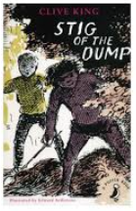
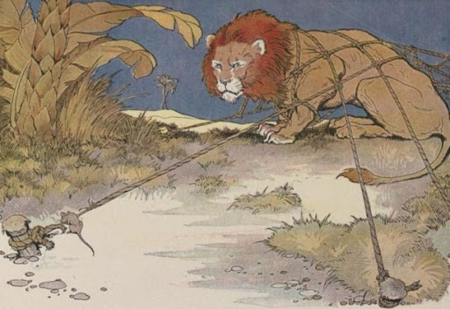
Year 3 Newsletter
Spring 1—2024/2025
Notices and Reminders
PE remains on Wednesday for this term.
Homework
Reading 5 x a week
TTRS 5 x a week
Optional will tasks will be sent home throughout the term.
Please make sure children bring coats, reading books and water bottles to school each day.
Key dates
Monday 6th January – Term begins.
Friday 17th January - INSET day
Half term
17th – 21st February
Please look at Headlines for future dates.
Reading
This term's focus text is 'Stig of the Dump' by Clive King. This children's novel explores how a young boy named Barney encounters Stig – a caveman and how they quickly become friends. They learn to communicate without
any language as Stig does not
speak any English. The children
will explore the new vocabulary they
come across and continue to answer
a range of comprehension questions.
Writing
This term's focus in language is starting with learning to choose appropriate determiners as well as learning about different prepositions that express time, place or cause.
During composition lessons the children will be learning, planning and writing a meeting tale based on the Aesop's
fable The Lion and the
Mouse. They will then be
writing a persuasive text
about why dogs are great!
Maths
In maths this half term, the children will continue to improve their understanding of multiplication. The children will continue to practise their multiplication tables focusing on the 2, 4 and 8 times tables. They will also learn how to multiply and divide a 2-digit number by a 1-digit number.
The children will then move on to learn about length and perimeter. They will learn how to measure accurately in cm, m and mm. Then they will use this knowledge to help them work out the perimeter of shapes and objects.

Slide 2


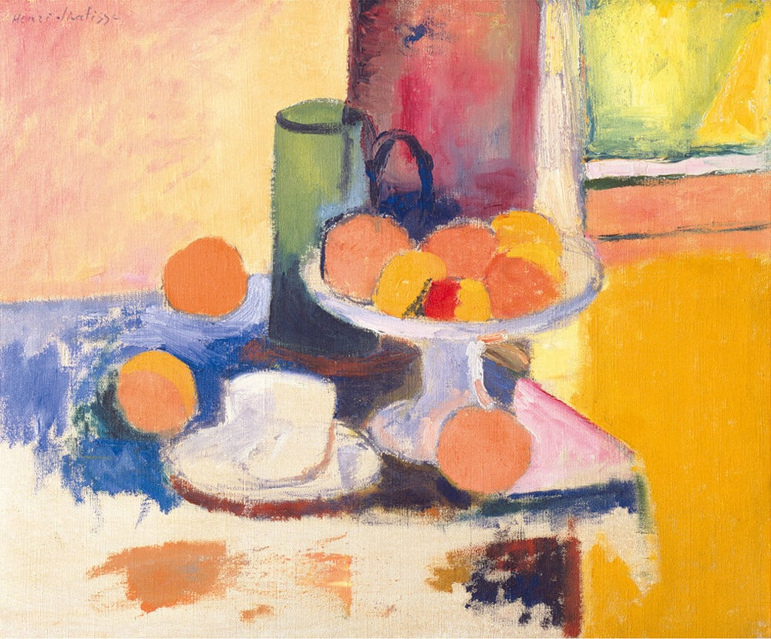
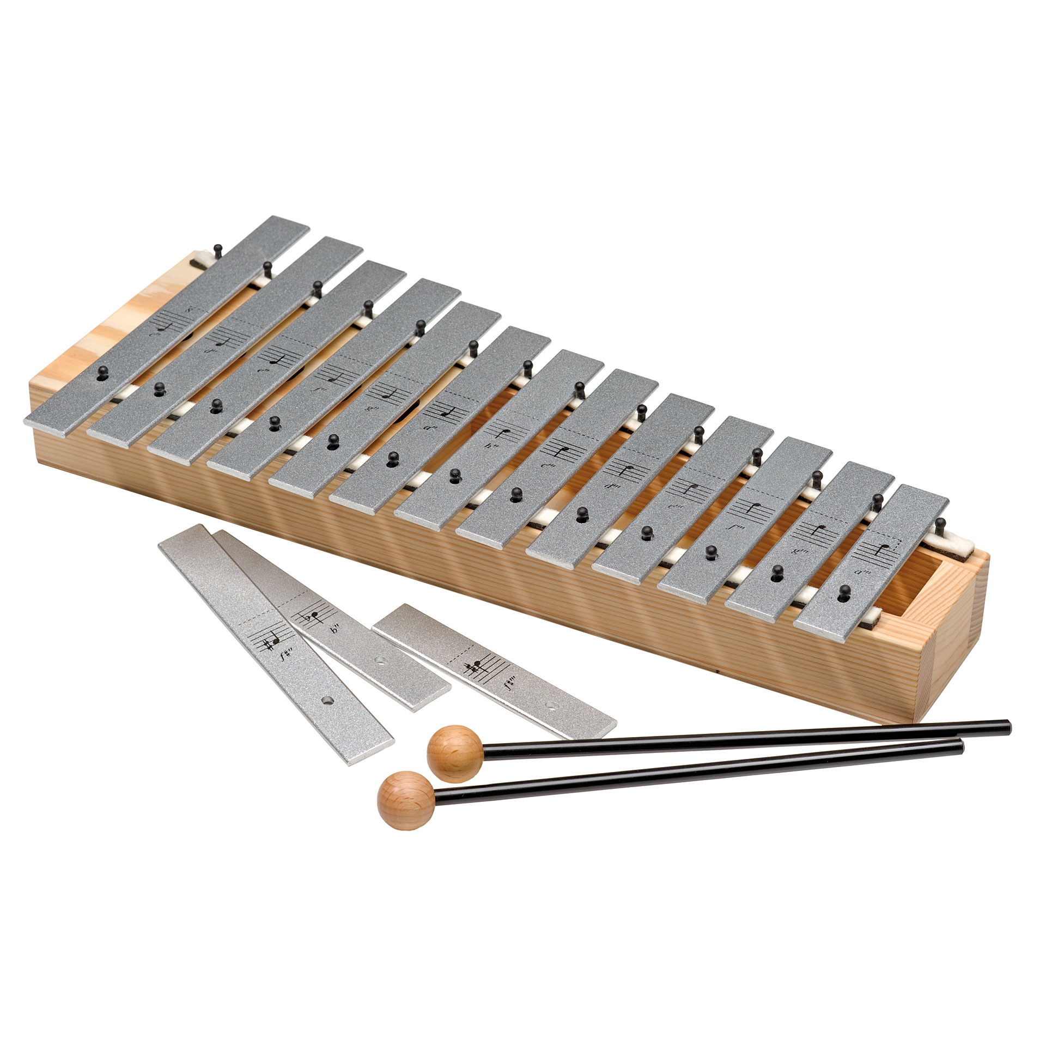
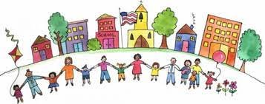
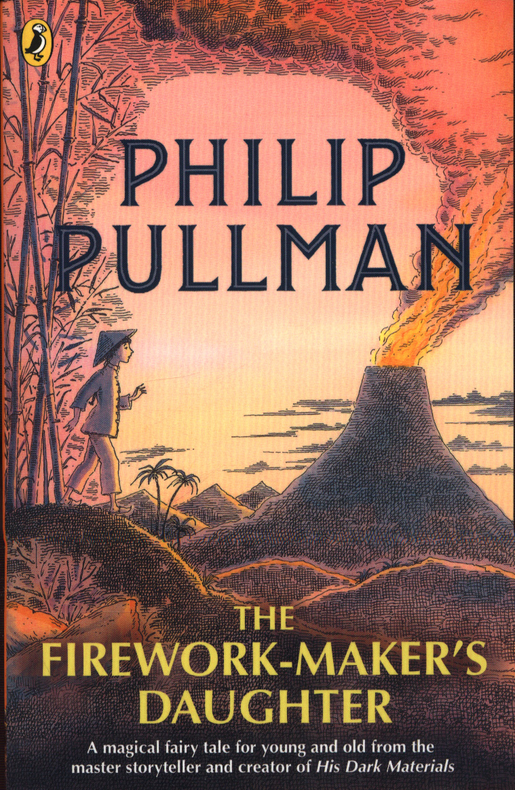
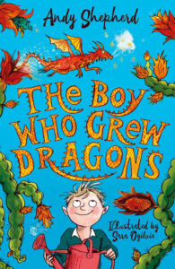
Science
In science this half term, the children will focus on forces and magnets. They will investigate how friction affects the way that objects move on different surfaces. After learning the properties of magnetism, the children will research which materials are
magnetic and which are not,
through identification and
classification.
Geography
In geography this term, the children will begin by exploring the continents and oceans of the world before learning about the differences in their climate. They will then go on to focus on Africa. After understanding Africa's location, the children will identify its physical and human features. Finally, they
will look at Ethiopia in close detail
- a country that they had
discussed last half term in reading.
Art
In art this half term, the children are going to explore the artist Henri Matisse, focusing on his still life paintings. They will explore the use of watercolour paints and create their own backwash, before creating their own still life arrangements with different objects. They will consider how the
arrangement of objects can
impact how a painting looks.
PE
In PE this half term, the children are going to be improving their flexibility, strength and balance in gymnastics! They will recap forward rolls before moving on to learning backward rolls and teddy bear rolls. They will then learn how to sequence these into a short routine with smooth transitions. The children will also
learn about Beth Tweddle, a successful British gymnast.
Music
In music this half term, the children are going to be using glockenspiels to practise recreating pieces of music. They will have opportunities to focus on the key notes used within each genre and improvise their own melody. The children will also be learning how long and short (rhythm) and high and low (pitch) sounds can be represented by musical symbols.
PSHE
In PSHE this half term, the children will be looking at what makes a community. To do this, they will learn about diversity, equality and equity. Towards the end of the half term, the children will learn what a stereotype is and will learn to challenge them.
French
In French this half term, the children will be focussing on phonics and pronunciation. They will learn a selection of phonemes which will help them to pronounce French words accurately. Through the unit, the children will practice hearing and saying the sounds individually, then in a word and finally in a piece of text.
Suggested books for reading
The Firework Maker's Daughter by Phillip Pullman,
The Boy Who Grew Dragons by Andy Shepherd

