Slide 1
The Grove Primary School
Welcome to Reception

Slide 2
What will we cover?
The Reception Team
What is the EYFS?
Communication and home school links
What starting at school looks like
Practical stuff like what you need
How to support your child with the transition
What’s coming next?

Slide 3
EYFS team
Head of Academy – Mrs Lynn Wicksey
EYFS Lead – Miss Amy Taylor
Dragons Class
Teacher – Miss Amy Taylor
Unicorns Class
Teacher – Mrs Wendy Darmanin
Learning Support Assistants – TBC

Slide 4
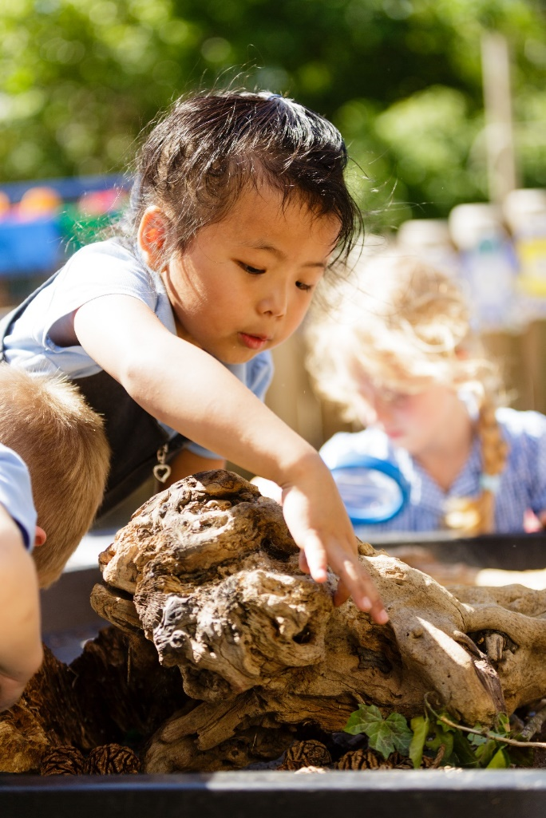
The Early Years Foundation Stage

Slide 5
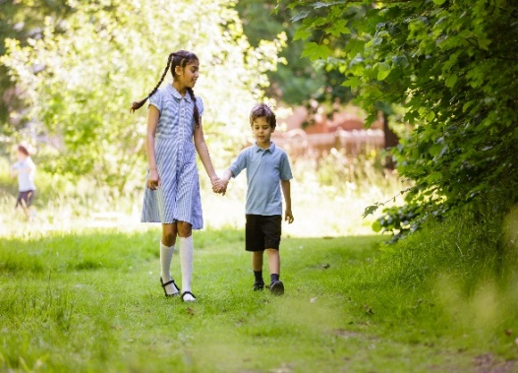
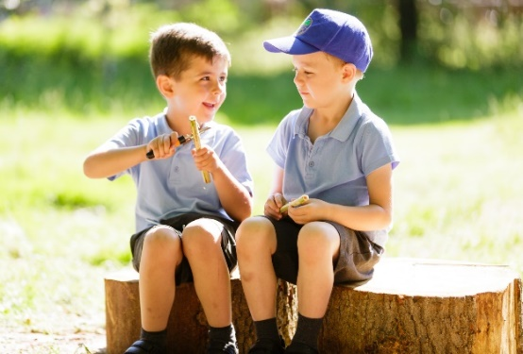
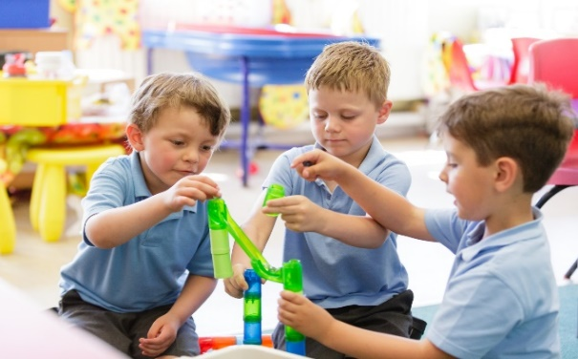
What is the Early Years Foundation Stage?
Prime Areas
Communication and Language
Listening and Attention
Understanding
Personal, Social and Emotional Development
Self Regulation
Building Relationships
Physical Development
Gross motor skills
Fine motor skills
Managing Self

Slide 6
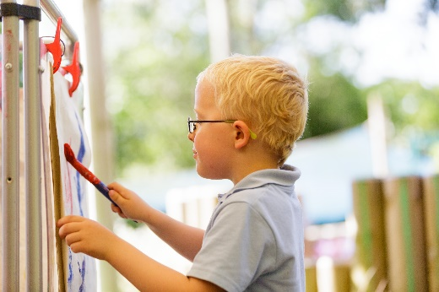
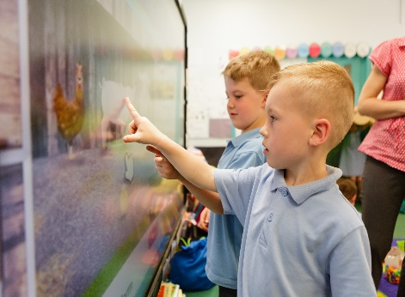
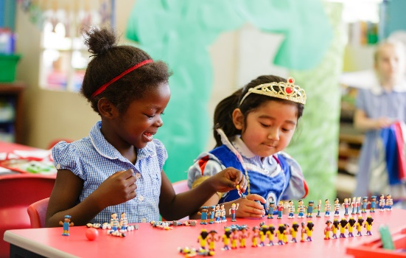
What is the Early Years Foundation Stage?
Specific Areas
Literacy
Comprehension
Maths
Number
Understanding of the world
Past and present
The natural world
Expressive arts and design
Word reading
Writing
Numerical patterns
People, culture and communities
Creating with materials
Being imaginative and expressive

Slide 7
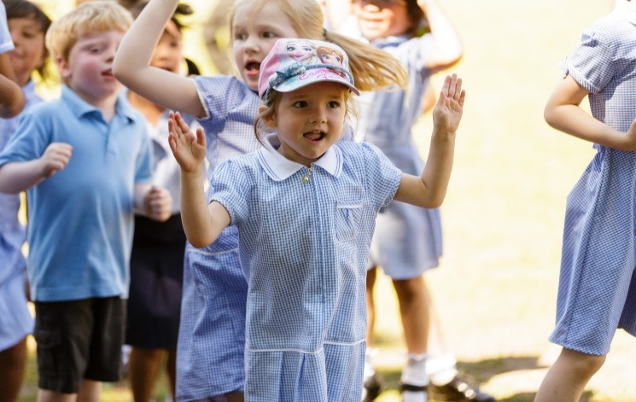
What happens when my child starts school?

Slide 8
Transition
Below is the transition model we use to welcome children into school. It is staggered to give them time to adjust and adapt tot heir new surroundings. This may not be right for all children so please speak to us if you have a concern.
June
Thurs 23rd June | 6pm New to Reception Parent Information Evening
July
Thursday 30th June | Stay and play September to Feb born - 9.30 a.m. – 10.15 a.m. March to August born - 10.30 a.m. – 11.15 a.m.
Tues 5th July | 1.30 Whole class story
September
Mon 5th Tues 6th | 1:1 visits with parents In school – timetable to follow
W/C | Wednesday 7th | Thursday 8th | Friday 9th | Monday 12th
September –February born | 9-12 | 9-1 + lunch | All day | All day
March – August born | 1-3 | 1-3 | 9-1 + lunch | All day

Slide 9
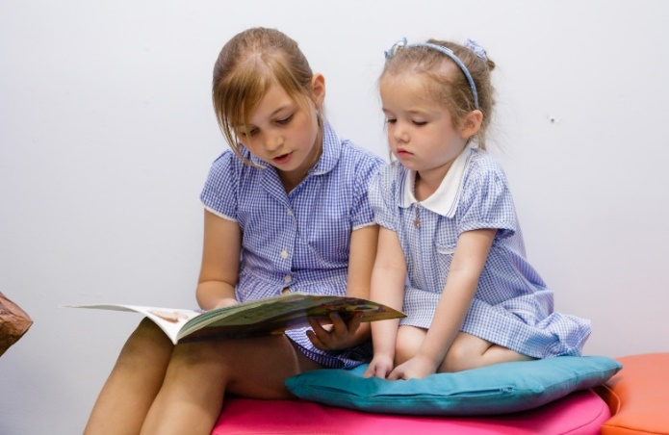
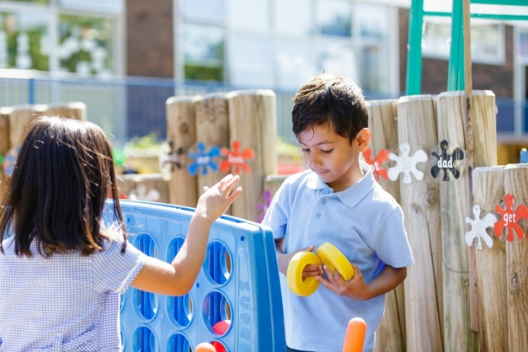
A day in the life of Reception
Start of day | Children will be welcomed by their teacher at the classroom door. Then they will start their early morning routine such as hanging their things up and self-registering.
Morning | Funky Fingers There will a selection of activities around the classroom that the children can select to help develop fine motor skills.
 | Phonics The children will be introduced to new sounds using games songs and actions.
 | Introduction to the day’s learning
 | Independent Learning This will be linked to the learning above, the children will be encouraged to undertake activities that are engaging and collaborative, both inside and outside.
 | Snack time An opportunity to come together, talk about the learning that has happened so far and refuel with a healthy snack.
 | Independent learning
 | Tidy up and review/celebration of learning.
Lunch | Lunch and playtime – an opportunity for free play and socialising
Afternoon | Regulation station - during this time we may do yoga, mindfulness or stretches to help us get ready to learn again.
 | Introduce afternoon learning
 | Independent Learning Adults will use this opportunity to spend time with the children, joining in and extending their play.
 | Story time Home time!

Slide 10
What do I need?
PE Kit
Our PE uniform is the same for all children.
Summer
House t-shirt (printed with the school logo)
Navy blue shorts
White socks
Trainers
Winter
House t-shirt (printed with the school logo)
Navy blue joggers
Grove hooded jumper
White socks
Trainers
Our Reception PE day is Thursday.
On that day, children to come in ready in their PE kits.
School uniform
Reception and Key Stage 1 Uniform
All year round
Grey skirt/pinafore dress or grey school trousers
Pale blue collared polo shirt
Royal blue sweatshirt/cardigan with school logo
Grey tights or grey socks
Black shoes (with an ankle strap or support)
Optional Summer Uniform
Blue and white striped or check dress
Sandals with closed in toes
Grey shorts
Wembley | Oval
Twickenham | Wimbledon
Everything named please!
School Uniform with The Grove logo (jumpers, cardigans etc) can be ordered from https://www.brendas.co.uk/

Slide 11
What do I need?
A named water bottle (that they recognise)
A book bag or backpack
Packed lunch (if required)
Coat
Wellies
Spare set of clothes
Everything named please!

Slide 12
Preparing your child for school
Emotional | Physical
Talk to your child about what they are most looking forward to at school | Dress themselves including zips
Know how to ask for what they want/need | Use the toilet independently
Create opportunities for your child to separate from their main carer (in line with current Government guidelines) | Use cutlery
Look at the school’s brochure, prospectus or website together and talk about the pictures. | Being used to tidying up when an activity is finished – ‘choose it, use it, put it away’
If your child is anxious about starting school you could practise the school run together, focus on things they enjoy, read books together about starting school. | Using a tissue to ‘catch it, bin it, kill it’
Share your own positive memories of school. | Being able to wash their hands
To help your child prepare for school, there are a few things that will help them.
We recognise that their emotional preparedness is as important as their physical readiness and have suggested a few things that may help.
We’re here to help so please email or contact via Seesaw if you have any questions or concerns.

Slide 13
Phonics and Reading
Phonics is the system we use to teach children to read
We follow a scheme called ‘Essential Letters and Sounds’
We do Phonics every day at 9am
Regular reading is a huge part of your child’s journey and it will help them develop skills that they will use throughout their education
We will send home a reading book each week which matches the sounds we are teaching in school
We start out learning every week with a new story
Please see the Book Trust website for lots of suggested reads
Best Books for 4-year-olds | BookTrust

Slide 15
Seesaw
Seesaw is a private learning platform and communication tool that we use in class in a variety of ways.
We use Seesaw to record and share the ‘wow’ moments and new learning that the children have achieved.
It also has a message feature which means you can send messages directly to the teacher.
Download Seesaw Class app (learning) and Family app (messaging)
Sign up to both using the login provided.
Set a password. No one else can see your journal unless they are tagged.

Slide 16
Focus Children
In the Kite Academy, we use the Focus Child Approach. This is a shared approach between school and families and entails us spending much of the week supporting, watching, engaging with your child in the setting.
Each child is focus child twice over the course of the year.
During this time:
Our observations on Seesaw will be focused on your child
We will ask you to contribute with a questionnaire which helps to inform our knowledge of your child
We will also give the children opportunities to develop their communication and language skills such as sharing a favourite toy or picture from home with their peers
We will share this information with. you at the end of the week in a ‘weekly reflection’

Slide 17
Food and drink
School dinners
All children in Reception and KS1 are entitled to free dinners
You order these either daily or in advance via the SCO app
We cater to many special diets, if you have a particular requirement pleas email the school office and they will be able to put you in touch with the right people.
Milk
All new starters from September will be registered by the School to receive milk automatically. However if you do not wish your child to receive milk, please email your request to: della.johnson@grove.kite.academy

Slide 18
Wrap-around Care
‘The Club’
We have an on-site breakfast and after school club which runs from 7.30am until the start of the school day and then from the end of the school day until 5.45pm.
Run by Vicky Mannion and offers a wide range of activities
They also offer holiday club provision as well

Slide 19
What’s next?
Thursday 30th June - Stay and Play
Tuesday 5th July - Whole Class Story
We will also send out timetables for the 1:1 visits in September. We will send these via Seesaw and email.

Slide 20
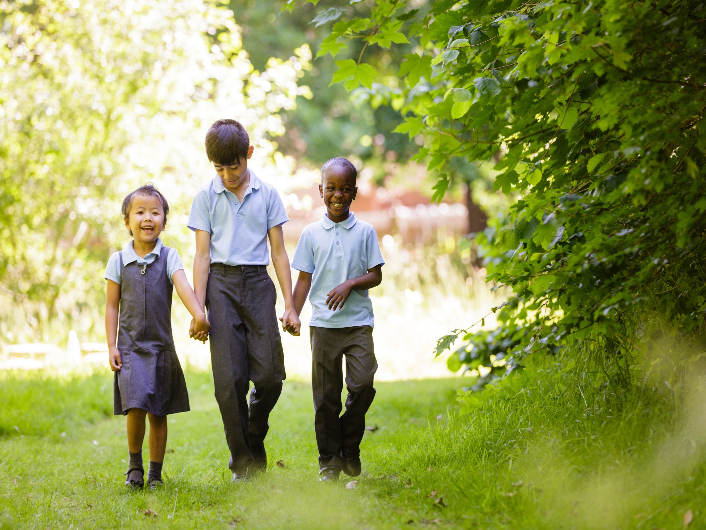
Thank you.
If you have any questions, please contact Miss Taylor via Seesaw.

