Slide 1
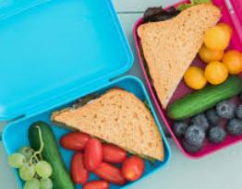
EYFS Newsletter
Summer 1– 2024/25
Notices and Reminders
PE DAY
Unicorns – Wednesday
Dragons – Friday
Please come into school in
PE kit on these days.
Books will be changed on a FRIDAY.
Key dates
Wednesday 30 April – class photo
Wednesday 30 April – Fire Service visit
Thursday 1 May – The Look Out school trip
Monday 5 May – bank holiday
Tuesday 6 May – Chicken eggs arriving (life cycles)
TBC May – caterpillars arriving (life cycles)
Friday 23 May – last day
Monday 26 May – half term
Communication and Language
In this half term, the children will be learning how to ask a question using who, what, where, why, when and how as a starting point. Through Talk for Writing, the children will be learning to use connectives to link their ideas together. The children will also continue to learn a range of rhymes and songs to support their learning.
Physical Development
This half term, the children will focus on developing their balancing skills on various apparatus, ensuring they can do so safely. They will also practice traveling around, over and through different pieces of apparatus to build their coordination and confidence. The children will have the opportunity to create short sequences that incorporate shapes, balances and traveling actions to encourage creativity and physical expression. Additionally, they will learn how to jump safely from a height by focusing on technique and safety.
Personal, Social and Emotional Development
This half term, the children will be learning all about keeping healthy. They will be thinking about which foods we should be eating more or less of and the importance of sleep. The children will learn why exercise and hygiene including brushing their teeth is important. The children will learn about how to show respect for each other and how they can work as a team.

Slide 2
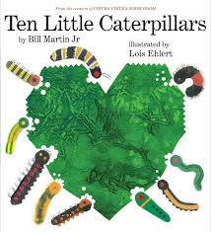
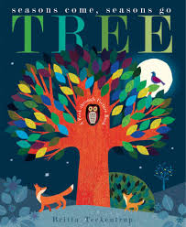
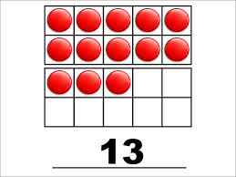
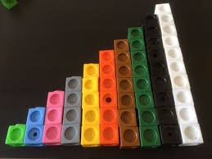
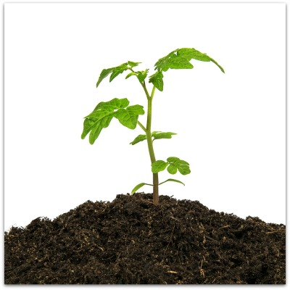
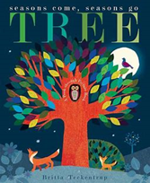
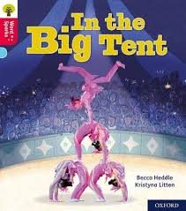
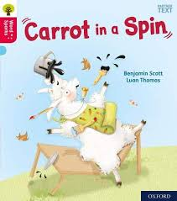
Literacy
In phonics, the children will be revising all the sounds taught so far and they will have many opportunities to apply them in different contexts.
In Talk for Writing, the children will be learning 'The Tiny Seed', 'Ten Little Caterpillars' and 'Tree'. They will be continuing to access their writing toolkit to encourage them to self-correct for finger spaces, full stops and capital letters each time they write.
Mathematics
In maths, the children will begin to build numbers beyond ten. They will use resources to support their understanding of the higher numbers. The children will explore increasing and decreasing amounts through addition and subtraction. As part of the unit on shape, the children will explore turning and rotating shapes to fill a space and how shapes can be combined or separated to make new shapes!
Understanding the World
The children will be learning what a plant needs to survive, parts of a plant and the life cycle of a plant. The children will go on to learn about the life cycle of caterpillars. The children will also be continuing to learn more about our world such as where we live and what is it like to live here. The children will then learn about other countries and beliefs from around the world.
Expressive Arts and Design
The children will be learning how to draw more detailed pictures of people and things they observe in the environment. The children will be taught how to make a moving mechanism using a range materials. They will continue to explore different movements in dance and will learn and rehearse a poem ready for a performance!
Homework
Please continue to read with your child five times a week. To support the children’s developing comprehension, you can ask questions about the books they have read to you and the books you read together.
Suggested books for reading

