Slide 1
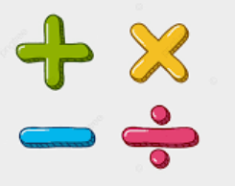
Year 6 Newsletter
Autumn 1—2024/2025
Key dates
16.9.24: Meet the teacher sessions in classrooms at 3:30pm
10.10.24: Year 6 Hindleap Warren Residential meeting school hall 6.00-6.30pm
28.10.24 – 3.11.24: Half-term
4.11.24 – 8.11.24: Hindleap Warren Residential
(If your child is not going on the trip, they need to attend school as usual)
Notices and Reminders
Year 6 PE day: Monday
Please make sure water bottles are in school everyday.
Homework:
Homework will be set on Fridays and due in the following Friday.
Reading 5 times per week recorded by an adult in reading diaries
TTRS 10 minutes on 3 days per week
Maths and grammar worksheets
Homework plays an important role in year 6 as we begin to prepare them for secondary school.
Reading
In Year 6, children take part in daily whole class reading lessons. This term, we are sharing a book called 'The Giver' by Lois Lowry. This book sets out with the intentions of describing a 'utopia' but throughout the novel, we find that the community could be described as a 'dystopia'. Throughout the lessons,
the children will discuss key
vocabulary and questions
that improve their understanding
of the text.
Writing
In writing this half term, the children are learning about different aspects of grammar. They will use these aspect of grammar to create exciting narratives in shared writes and in their own independent writing.
Maths
In maths this half term, the children will begin by recapping place value, including comparing, ordering and rounding numbers up to 10,000,000. They will continue to develop their knowledge and reasoning skills with the four operations, including learning the method of long division, as well as the order of operations (BIDMAS).

Slide 2
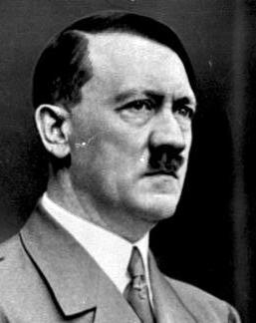
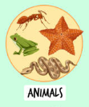
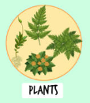
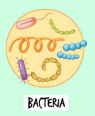
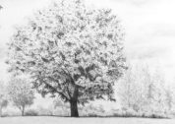
Science
In science this half term, the children will learn about the similarities and differences among plants, animals and microorganisms. They will learn about the scientific contributions to the study of living things of Carl Linnaeus, Louis Pasteur and Kizzmekia Corbett.
History
During the autumn term, the
children will be learning about how
Adolf Hitler rose to power. This will
focus on Hitler becoming leader of the Nazi party and dictator of Germany, the use of propaganda to spread the Nazi ideology and the ways in which Jews and non-Aryans were persecuted. The children will look at sources to support their learning such as first-hand accounts of those who lived during that time.
Art
In art this half term, the children will begin to look at tone, texture and mark-making. They will then use a range of strategies to create perspective in our own drawings. They will study Cézanne in this unit and make direct comparisons to our study of Monet and Impressionism.
PE
This half term the children will be playing football. They will be learning to pass, dribble and shoot with control. These skills, along with teamwork, will be incorporated into attacking and defensive tactics.
RE
In this half term, the children will be exploring the religions of Judaism and Sikhism. Specifically, in Judaism, they will learn about the importance of repentance and the impact this has on the way Jewish people live their lives. In Sikhism, the children will learn what it means to Sikhs to belong to their faith and how this happens in their community through the exploration of rituals and routines.
PSHE
In PSHE, the focus will be on what it means to be healthy. This includes both physical and mental health, understanding the importance of eating a balanced diet as well as maintaining good oral hygiene.
French
In this half term, the children will be focusing on how to say twenty- one pieces of clothing in French. They will be exposed to authentic French accents from around the world to enable them to speak with a French accent. They will also learn how to correctly use the verb 'porter'(to wear) as well as the genders of each item - 'la/le'.
Suggested books for reading

