Slide 1
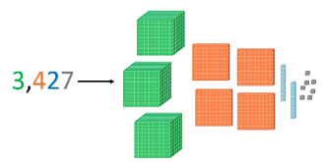
Year 5 Newsletter
Autumn 1—2024/2025
Key dates
16.9.24: Meet the teacher sessions in classrooms at 3:30pm
28.10.24 – 3.11.24: Half-term
Notices and Reminders
PE – every Thursday
Classroom Equipment:
Please ensure these are all in a small, clear pencil case.
a handwriting pen,
pencils,
ruler,
rubber,
green pen,
glue stick,
a small set of colouring pencils
Also
A lidded drink bottle.
PLEASE ENSURE ALL SCHOOL ITEMS ARE NAMED.
Reading
This term we are reading Where the Mountain Meets the Moon by Grace Lin. This is a fantasy adventure inspired by Chinese folklore, which tells of the quest of the protagonist (Minli) to change her family's fortune. Children have opportunities to listen and read aloud, as
well as reading independently.
During the lessons, we discuss
key vocabulary and questions that
improve their understanding of the
text.
Writing
In writing this term we are learning about different aspects of grammar. We have been using these aspect of grammar to create exciting narratives in our shared writes and in our own independent writing.
Maths
In maths, we are learning about place value, exploring the composition of numbers in a variety of representations. We will also be learning both mental and formal written methods of addition and subtraction.

Slide 2
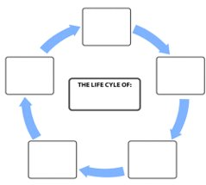
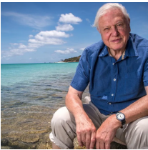
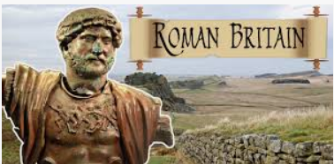
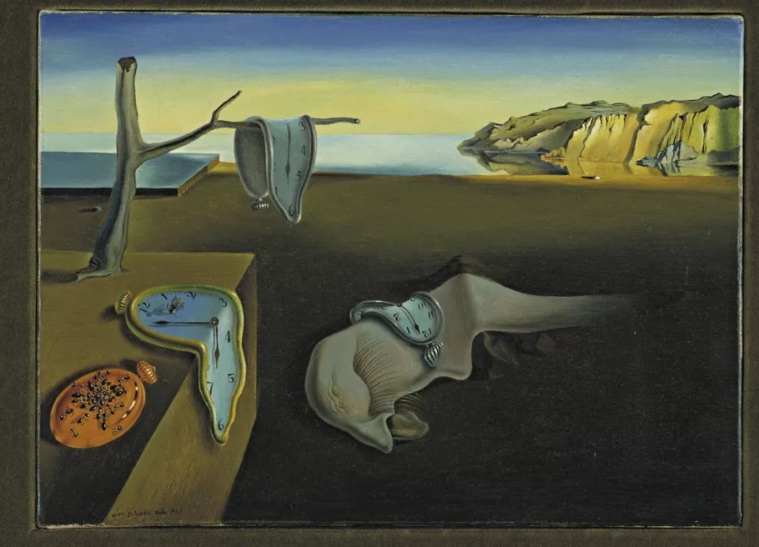
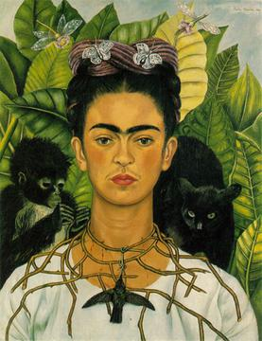
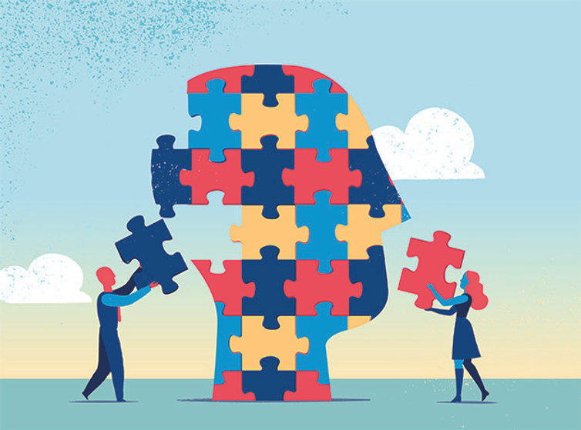
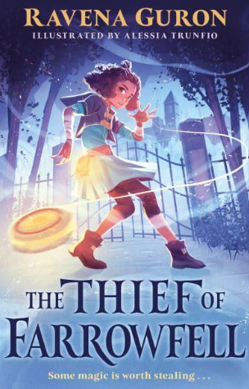
Science
This half term, we are learning how to describe the differences in the life cycles of a mammal, an amphibian, an insect and a bird. We will also describe the life process of reproduction
in plants and learn about famous naturalists.
History
In history this term, the pupils will be learning about how Britain was conquered by the Roman Empire and what life was like as a result. They will then explore how Britain was impacted by the withdrawal of the Roman Empire and the subsequent settling by the Anglo-Saxons.
Art
This half term we are looking at landscapes and how we can draw them using tone, shape and texture. We will then move on to look at Frida Kahlo and her contributions to surrealism before creating our very own surrealist landscapes.
PE
This half term:
David Attenborough will be focusing on invasion games, specifically netball. They will practise the skills of throwing, catching, pivoting, defending and attacking.
Bear Grylls will be focusing on Street Dance where they will learn a range of moves and bring them together for a dance sequence.
The classes will swap units after half term
RE
Our topic in R.E. this half term is Hinduism, specifically learning about their different beliefs. This will include learning about their God and His deities, reincarnation and how they believe they should live their lives.
PSHE
In PSHE this half term, we are focusing on our identities. We will look at what makes up our own identities and then speak about possible stereotypes and the impact these can have.
Homework
Homework will be given out every Friday, to be returned the following Friday.
The children should read at least 5 times per week and record this in their reading diaries. Parents – please sign and check these weekly. Diaries will be checked in school every Friday.
TTRS – children should do this 5 times per week for at least 10 minutes.
Suggested books for reading

