Slide 1





Year 4 Newsletter
Autumn 1—2024/2025
Notices and Reminders
As we move in to the colder weather, please ensure all children have a coat in school with them. The cold or rain won’t stop us going outside!
Please make sure that your child has their reading book and diary in school every day.
.
Key dates
Mondays
Reading diary check
Tuesdays
Year 4 will have PE on a Tuesday afternoon. Please send your children into school dressed in their PE kit.
Fridays
Home learning returned and sent home.
12th September – Year 4 Residential meeting 6pm in the hall.
16th September – Meet the teacher.
5th October - Last day of Autumn Half term 1.
Reading
This term the children will be reading a beautiful and immersive story set in the Himalayas called Asha and the Spirit Bird. Guided by a bird, which Asha believes to be the spirit of her grandmother, they set out to find her father. Packed with humour, wisdom and a satisfying twisty plot our story takes us on a magical journey that links nicely with our geography unit on the Himalayas later
on in the year..
Writing
In writing this half term, the children are learning about different aspects of grammar. They will use these aspect of grammar to create exciting narratives in shared writes and in their own independent writing.
Maths
This half term primarily focuses on developing the children's understanding of place value, such as recognising the value of each digit within a four-digit number. This includes using visuals such as dienes and counters to understand exchanging – how 10 tens can be exchanged into 1 hundred, etc.

Slide 2
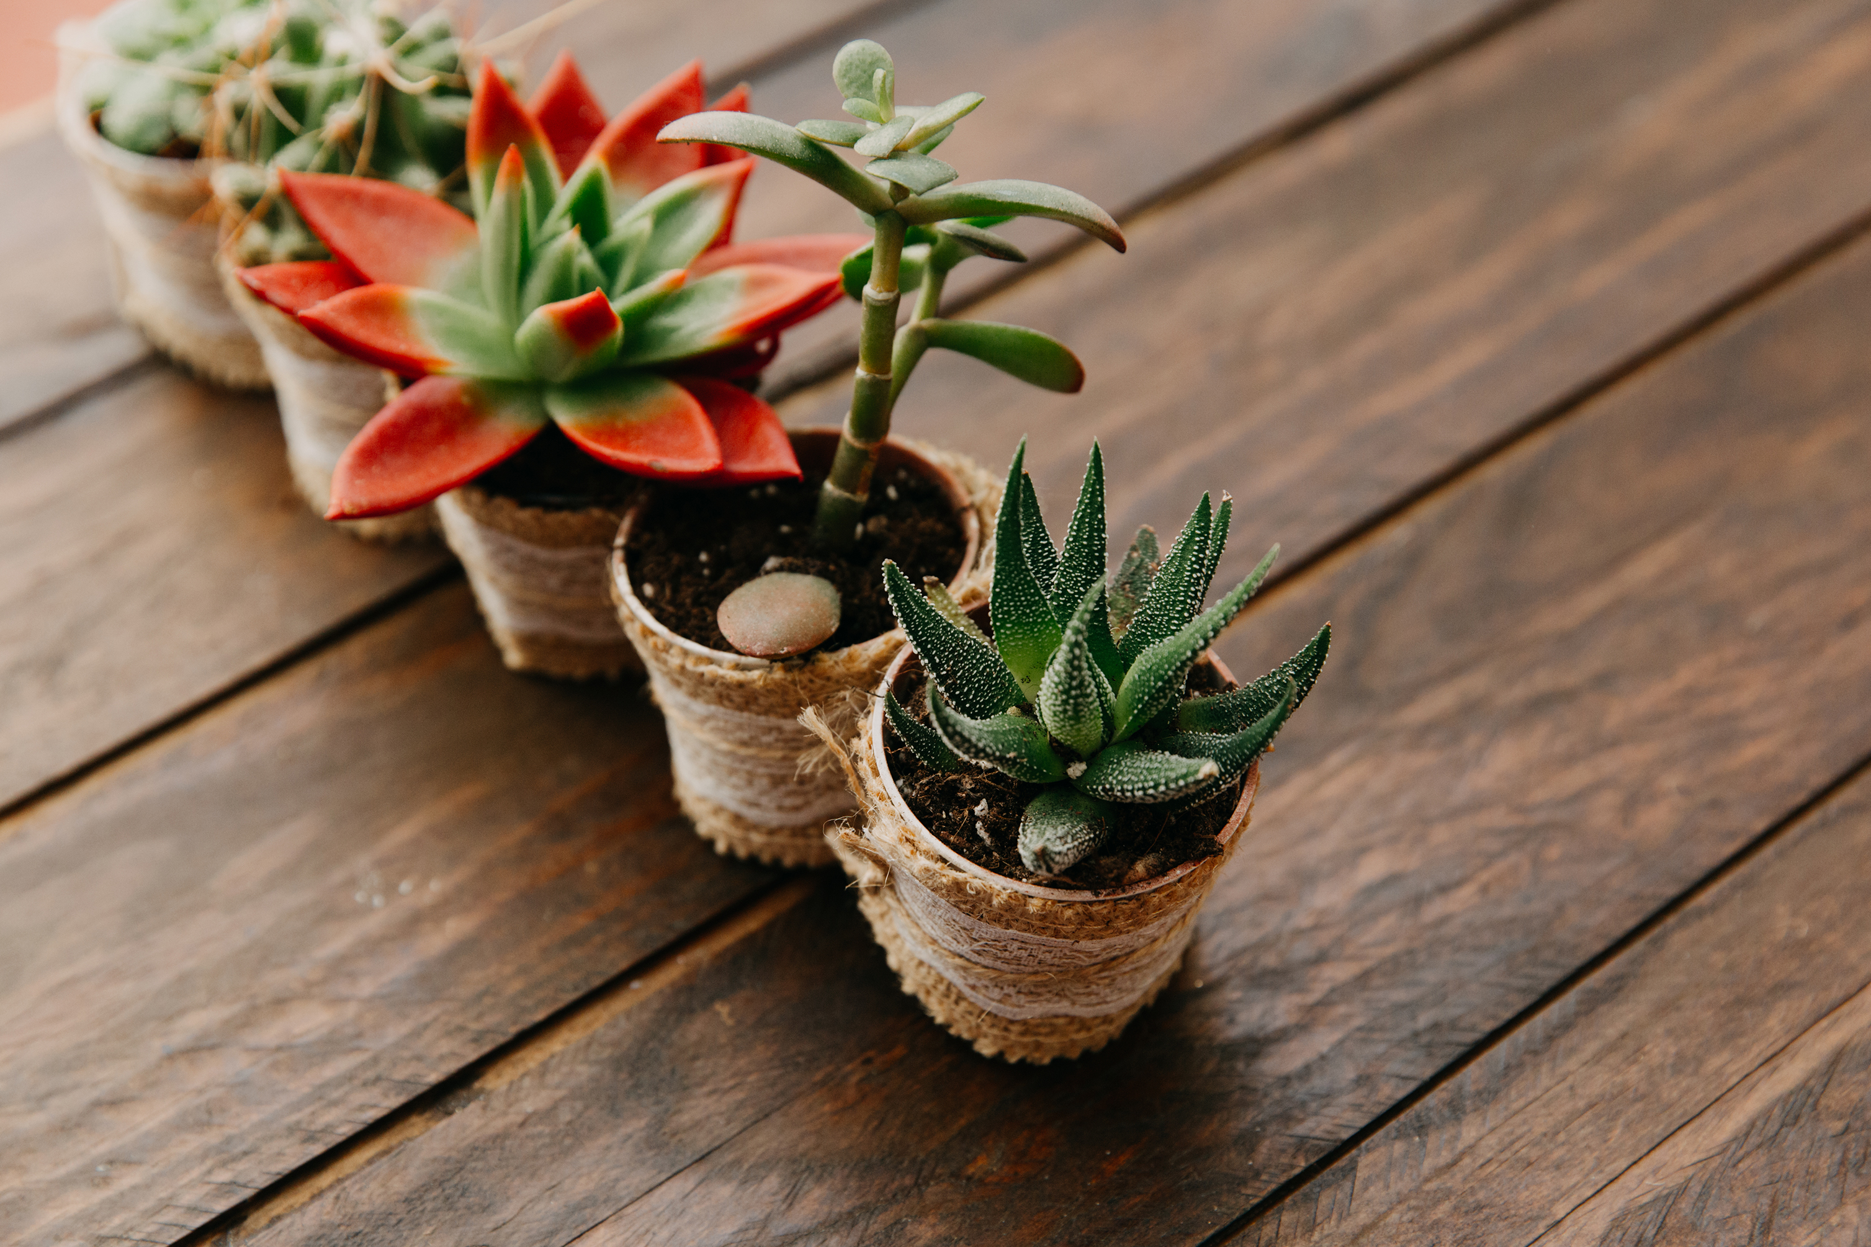
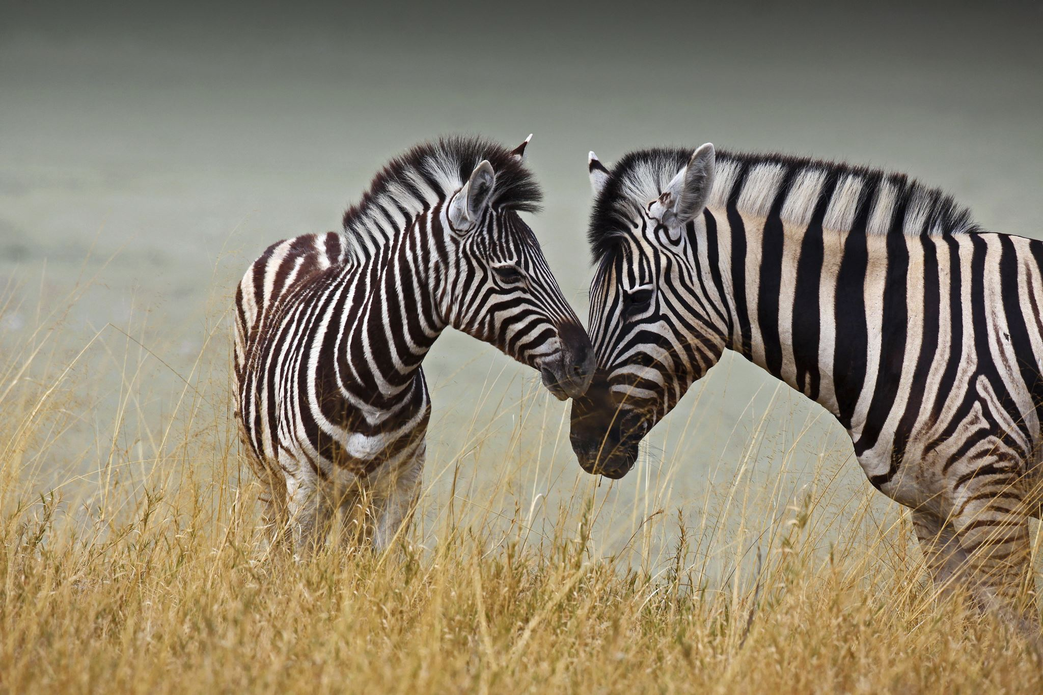
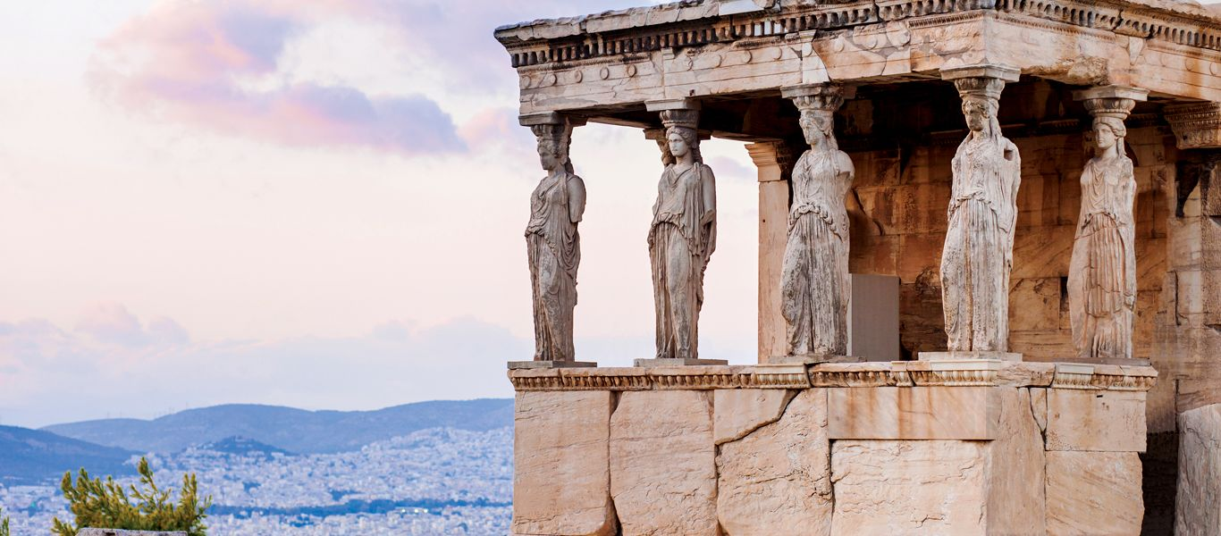
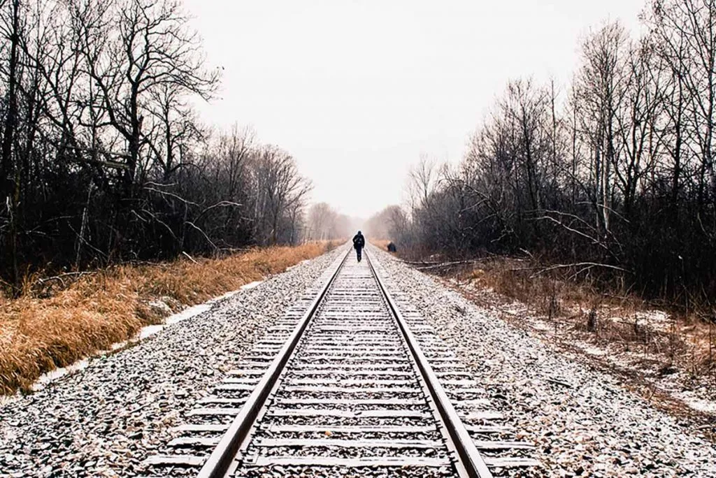
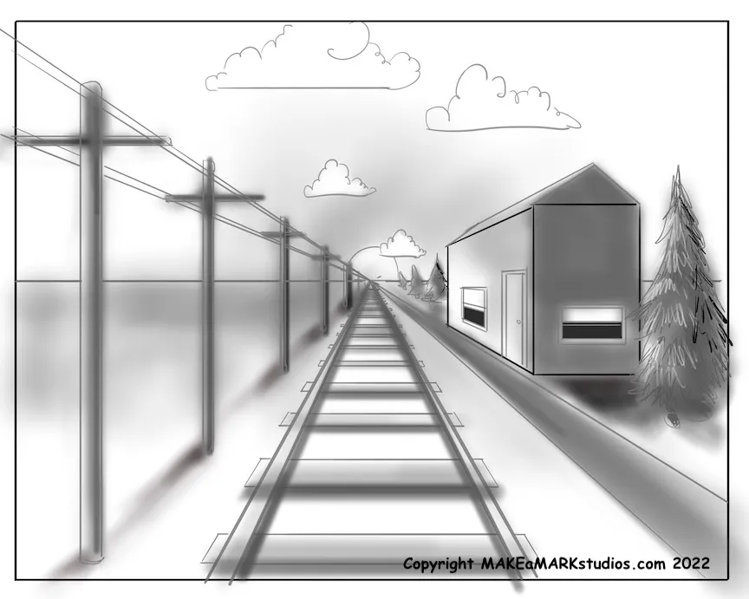
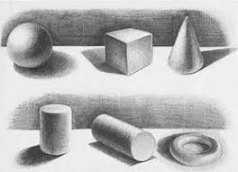
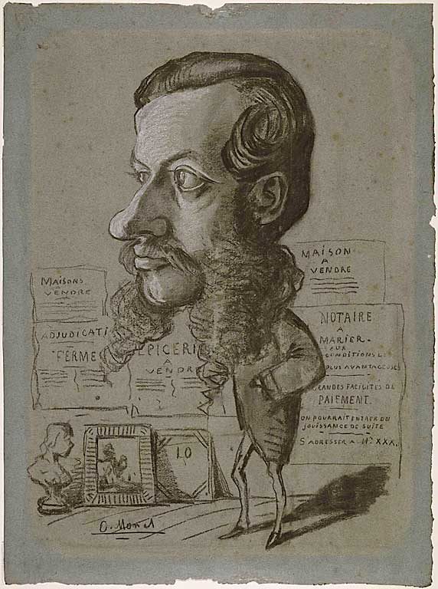





Science
This half term in science, the children will be learning about different ways in which they can classify organisms (plants and animals), such as vertebrates and invertebrates, physical features and behavioural features. They shall be learning about the impact that natural human causes can have on different habitats.
History
This half term in history, the children are learning about Ancient Greece. The children will be looking at Greek life and achievements, including the achievements of Alexander the Great, the Olympics, different Greek gods and goddesses. This will culminate in thinking about Ancient Greek culture.
Art
This half term in art, children are learning about perspective and how to create this in their art, using vanishing points and using shadows to show depth. The unit is linked to impressionism, with a focus on Claude Monet, who drew caricatures as a young artist.
PE
This half term in PE, the children in Lewis Carroll will be partaking in invasion game of football. The children will further develop their skills with a focus on dribbling, evading/outwitting an opponent and striking for accuracy and power. The children in Roald Dahl Class will be focusing on Bollywood dancing, culminating in performing their own group Bollywood dance. The classes will swap PE topics next half term.
RE
This half term in RE, the children are learning about pilgrimages; what they are, their purpose and their significance to different religions. The children will explore different Holy sites across the world from the UK to Israel, India, Italy and France, which will help with their geography skills too! This includes delving into Christianity, Islam, Judaism and Hinduism and explored the different aspects of their Holy journeys.
PSHE
This half term in PSHE, the children are looking at what our strengths, skills and areas of interests are. They will learn about self-esteem and some techniques that can improve this. They will then consider the impact that the media can have on our self-esteem and setting long and short-term goals (and how to achieve them).
French
This half term in French, the children will be learning about how to correctly pronounce their name, numbers up to 20, where they live and their nationality. This will include appropriate questions and answers which they are able to recognise and answer with increasing accuracy.​
Suggested books for reading

