Slide 1
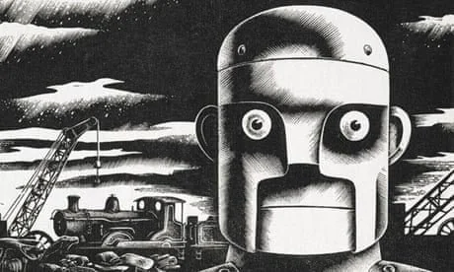
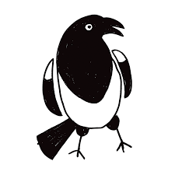
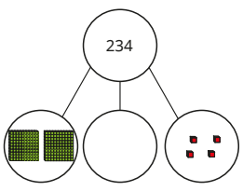
Year 3 Newsletter
Autumn 1—2024/2025
Notices and Reminders
As we move in to the colder weather, please ensure all children have a coat in school with them. The cold or rain won’t stop us going outside!
Please make sure that your child has their reading book and diary in school every day.
Key dates
Mondays
Reading diary check
Wednesdays
Year 3 will have PE on a Wednesday afternoon. Please send your children into school dressed in their PE kit.
Fridays
Home learning returned and sent home.
16th September – Meet the teacher.
5th October - Last day of Autumn Half term 1.
Reading
This half term in reading, the first text is 'The Iron Man' by Ted Hughes, a story about the destruction caused by a great metal robot before that robot is called to save the planet from a monster from outer space. The following text is 'The Fastest Boy in the World' by Elizabeth Laird. The children will continue to follow the text being read to them with their finger, as well as practise reading aloud to develop their fluency. They will also use evidence from the text to
answer questions.
Maths
This half term in maths, the children will continue to build upon their place value knowledge, extending to 3-digit numbers. They will become familiar with the size of each number, the value of each digit, partition numbers and use number lines. They will then move onto addition and subtraction, beginning with applying known number facts to larger numbers and begin to learn formal methods to solve calculations.
Throughout the term, they
will solve problems and answer
reasoning questions.
Writing
This half term in writing, the children will start by recapping key learning from year 2 using several picture prompts to inspire. They will then start their first unit - writing a journey story. The children will first immerse themselves in a text through orally retelling the story. They will then use their deep knowledge of the story structure to create their own version. Throughout the cycle, the children will be exposed to a range of skills that will help them develop their writing.

Slide 2
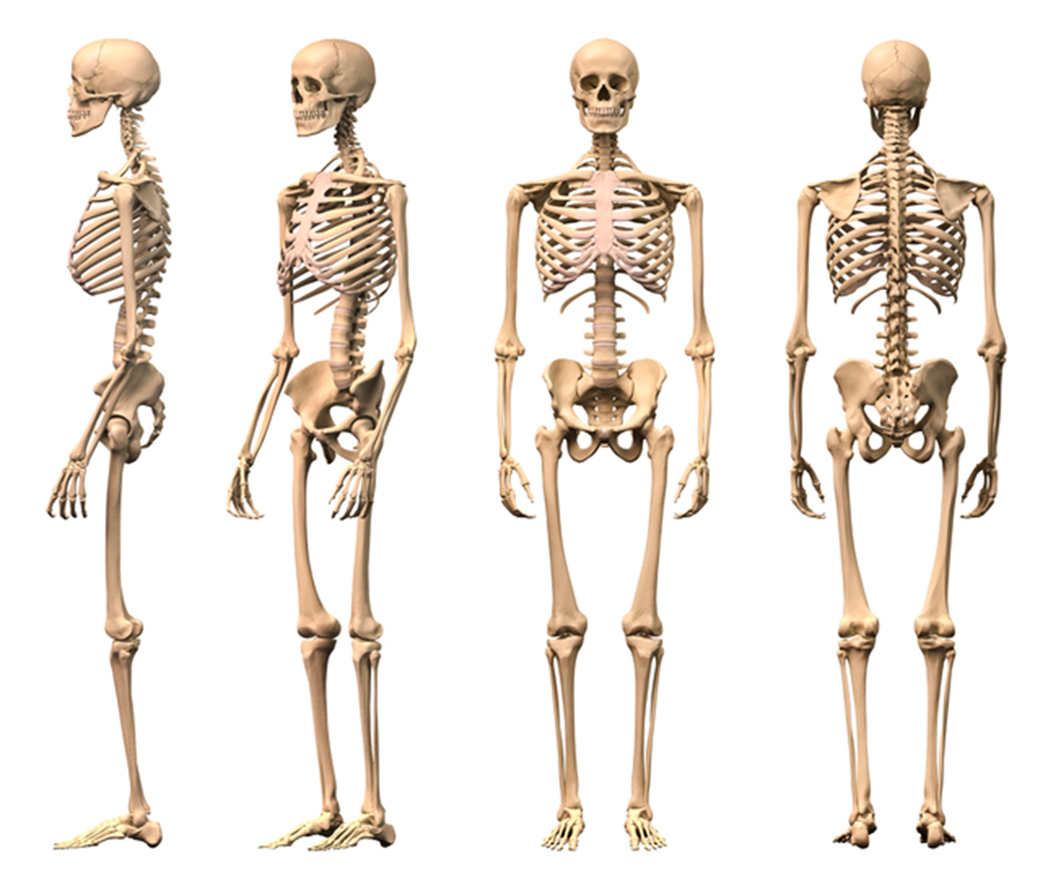
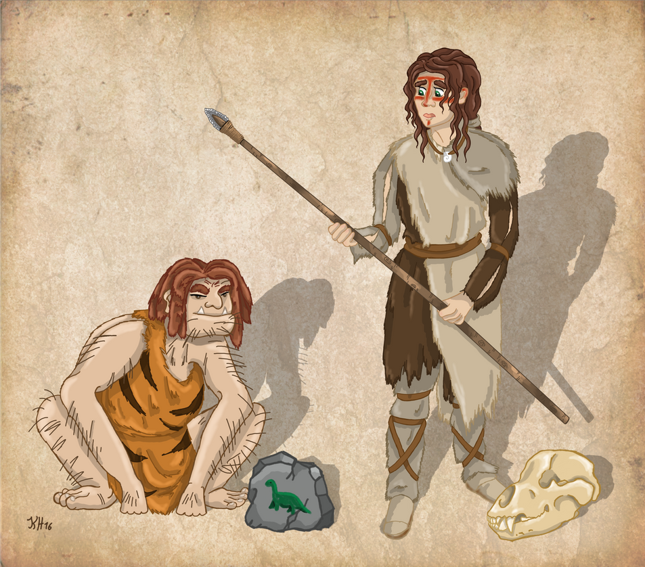
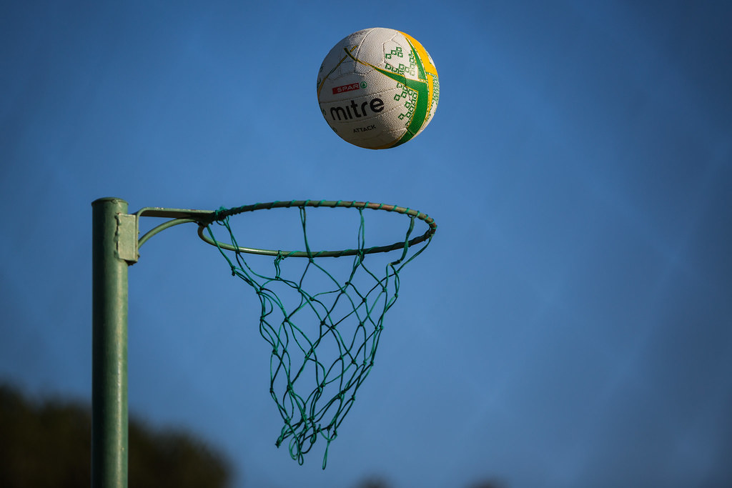
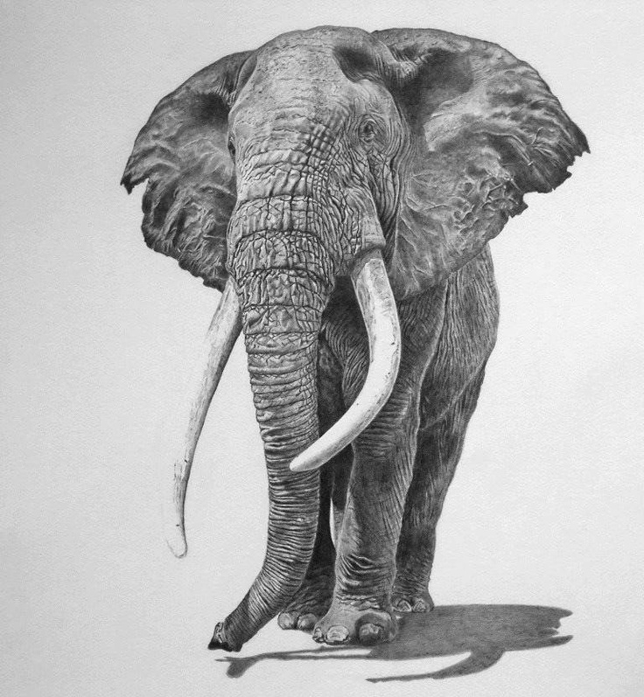
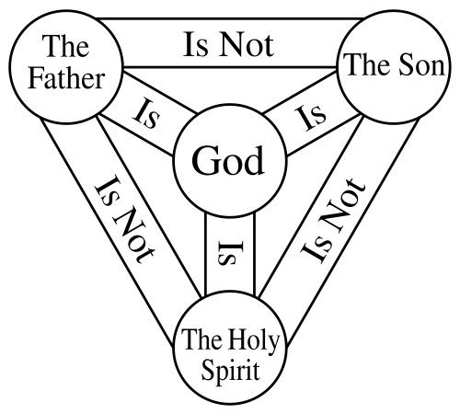
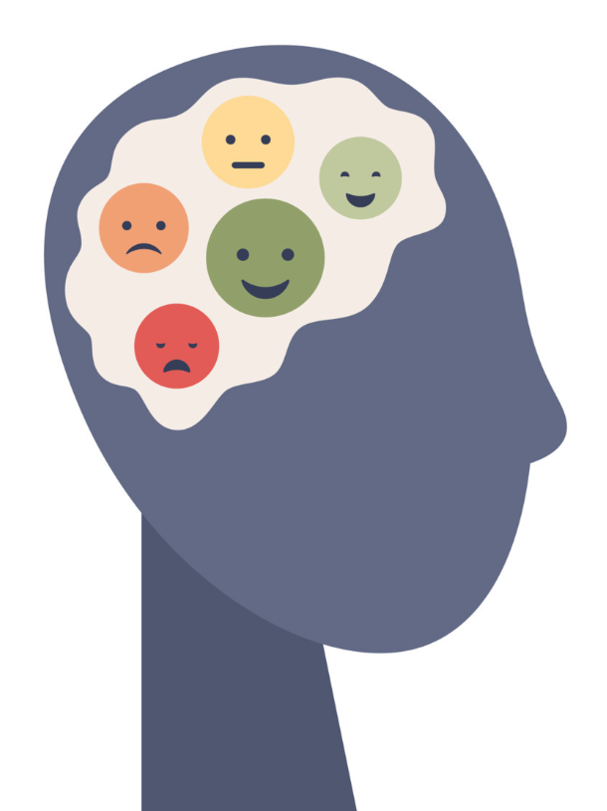
Science
This half term in science, the children will learn about skeletons and muscles. They will learn about different types of skeletons in all animals before focusing on the human body. They will look at different muscles and the function of
different bones in our body.
Towards the end of this term
they will look at what
nutrients they need to grow
and keep their bodies healthy.
History
This half term in history, the children will be learning about some of the key changes which occurred between the Stone Age and the Iron Age. They will be finding out how archaeologists use clues from artefacts and cave paintings to understand what life was like. They will also be comparing the Paleolithic,
Mesolithic and Neolithic eras.
Art
This half term in art, the children will learn the techniques and skills required for observational drawing. They will learn how to recognise abstract and observational art while studying the art of Henri Matisse. They will complete an observational drawing of an elephant using graphite pencil and then they will study Matisse's 'The Nightmare of the White Elephant' to inspire their own
abstract piece.
PE
In P.E this half term, the children will focus on invasion games. They will practise the skills of running, jumping, throwing and catching both in isolation and in competitive netball games. They will also be looking at attacking and defending.
RE
The Big Question in RE this half term is 'What is the Holy Trinity?’ The children will learn how Christians believe that God is revealed to them in three ways – God the Father, God the Son and God the Holy Spirit – yet remains one God.
They will also explore how all
denominations of Christianity
have the same principle beliefs
including The Holy Trinity, Bible
and resurrection of Jesus.
PSHE
This half term in PSHE, the children will learn how to recognise their own feelings and celebrate what makes each of them unique.
They will also learn about the importance of understanding what mental health is and
how to look after their mental
health using a range of strategies.
They will learn that it is normal
to experience a range of
emotions.
French
This half term, the children will begin with looking at where French is spoken across the world. They will learn about the geography and culture of France, including where it lies on a map and the tricolore. They will then learn greetings, the numbers from 1-10 and the
colours before moving onto
looking at adjectives.
Suggested books for reading

