Slide 1
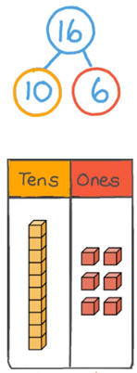
Year 2 Newsletter
Autumn 1—2024/2025
Notices and Reminders
PE is on Friday. Please send you child to school in their PE kit.
Please bring their book and reading diary every day to school.
Key dates
Friday 25th October - last day of Autumn 1.
Reading
In reading this half term, the children will begin reading 'Aesop's Fables'. In their reading lessons, they will look at some of new vocabulary words they encounter in more detail, answer comprehension questions and discuss the morals of the stories. The children will look at the features of fables and the ​literary techniques used in the writing.
Writing
In writing this half term, the children will immerse themselves in a journey tale through orally retelling the story. They will then use their deep knowledge of the story structure to create their own version. Throughout the cycle, the children will be exposed to a range of skills that will help them develop their writing.
Maths
In maths this half term, the children will learn to recognise the place value of each digit in two-digit numbers They will count in steps of 2, 3, 5 and 10 forward and backward and will start to identify and estimate where numbers are placed on a number line. They will also read and write numbers to 100 in
numerals and words and compare
them using the <, > and = signs.
We will then start on the
addition and subtraction unit.

Slide 2
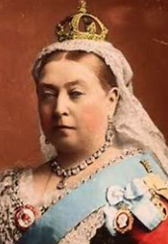
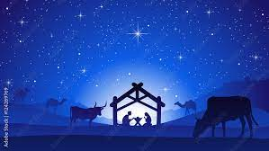
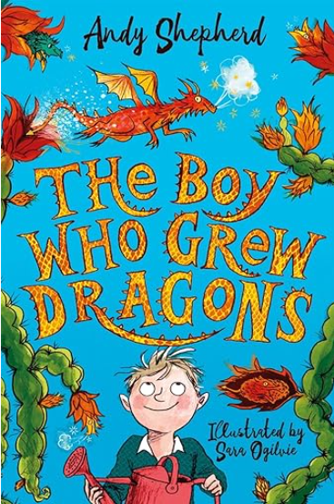
Science
In science this half term, our topic is animals, including humans. The children will focus on the life cycles of animals and humans. They will find out about the basic needs of animals and humans, and will describe the importance for humans to exercise, eat the right amounts of different types of food, and have personal hygiene.
History
In history this half term, the children will think like historians, discovering what life was like in the Victorian Era. They will be learning about Queen Victoria, the Industrial Revolution, inventors, and their inventions, and what life was like for children during this time in history.
Art
In art this half term, the children will be learning how to draw in the style of Pablo Picasso. The children will learn to draw using lots of different skills including shading and hatching. The children will learn about the artwork of Pablo Picasso and Cubism before creating their own portraits inspired by what they have learned.
PE
Mary Seacole will focus on invasion games, working specifically on developing football skills. The children will explore dribbling, turning in different directions as well as learning how to lose an opponent and create space to score a goal! Florence Nightingale will be focusing on dance. The children will develop their ability to control their bodies to perform different shapes and movements.
RE
This half term in RE, the children will be looking at why Christians celebrate Christmas. They will be looking at the similarities and differences of Matthew and Luke’s account of The Nativity and what the key differences are. They will then look at who Mary and Joseph were, who visited the manger and why Mary and Joseph took Jesus to Egypt.
PSHE
This half term the children will focus on recognising that they all have similarities and differences. They will explore their interests, inside and outside of school, touch on mental health and then explore physical differences -for example- height and hair colour; before finishing the term on their different personality traits.
Homework
Please listen to your child read at home. Once a child has read through their book 5 times they can change it on any day. As the children are have now began year 2 they will do this more independently so it is their responsibility to remember to change their book. They know what to do and know to come and ask their teacher if they forget!
Please do Times Table Rockstars 3 times per week for 10 minutes.
Suggested books for reading

