Slide 1
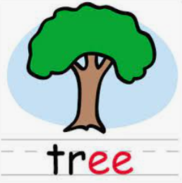
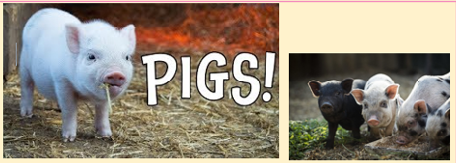
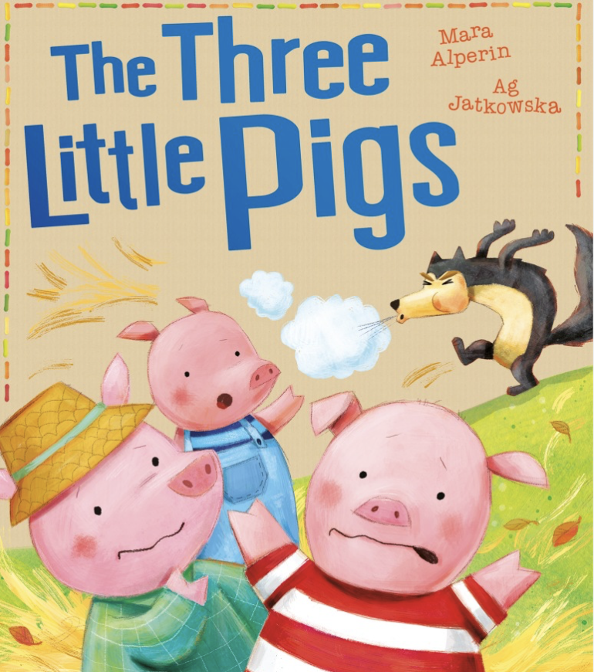
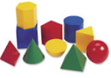
Year 1 Newsletter
Autumn 1—2024/2025
Notices and Reminders
PE Days are Tuesdays
New reading books will be handed out in week 4 as per our Essential Letters and Sounds phonics reading scheme's requirement
Key dates
Meet the teacher session: Monday 16th September
End of term: 25 October
Phonics
This half term in phonics, the children will be revising the phase 5 sounds:
<ay>, <ou>, <ie>, <ea>, <oy>, <ir>, <ue>, <aw>, <wh>, <ph>, <ew>, <oe>
Writing
This half term in writing, the children will be learning some stories by heart. They will then write them using their phonics. Finally, they will start to learn how to do some simple editing.
The texts the children will learn are:
The Three Little Pigs
Pigs!
Maths
This half term in maths, the children will be learning to count forwards and backwards., sorting and grouping objects and learning how to find one more and one less of a given number to ten.
They will finish the term by learning about 2D and 3D shapes.

Slide 2
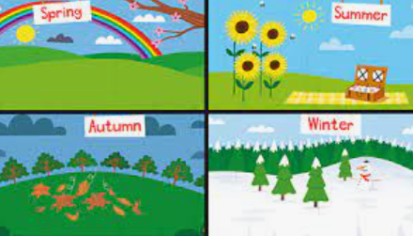
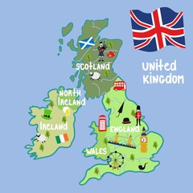
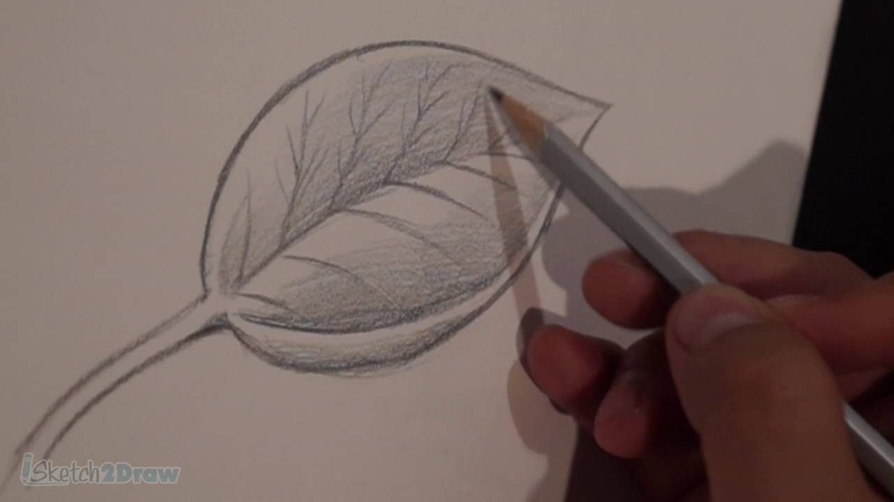
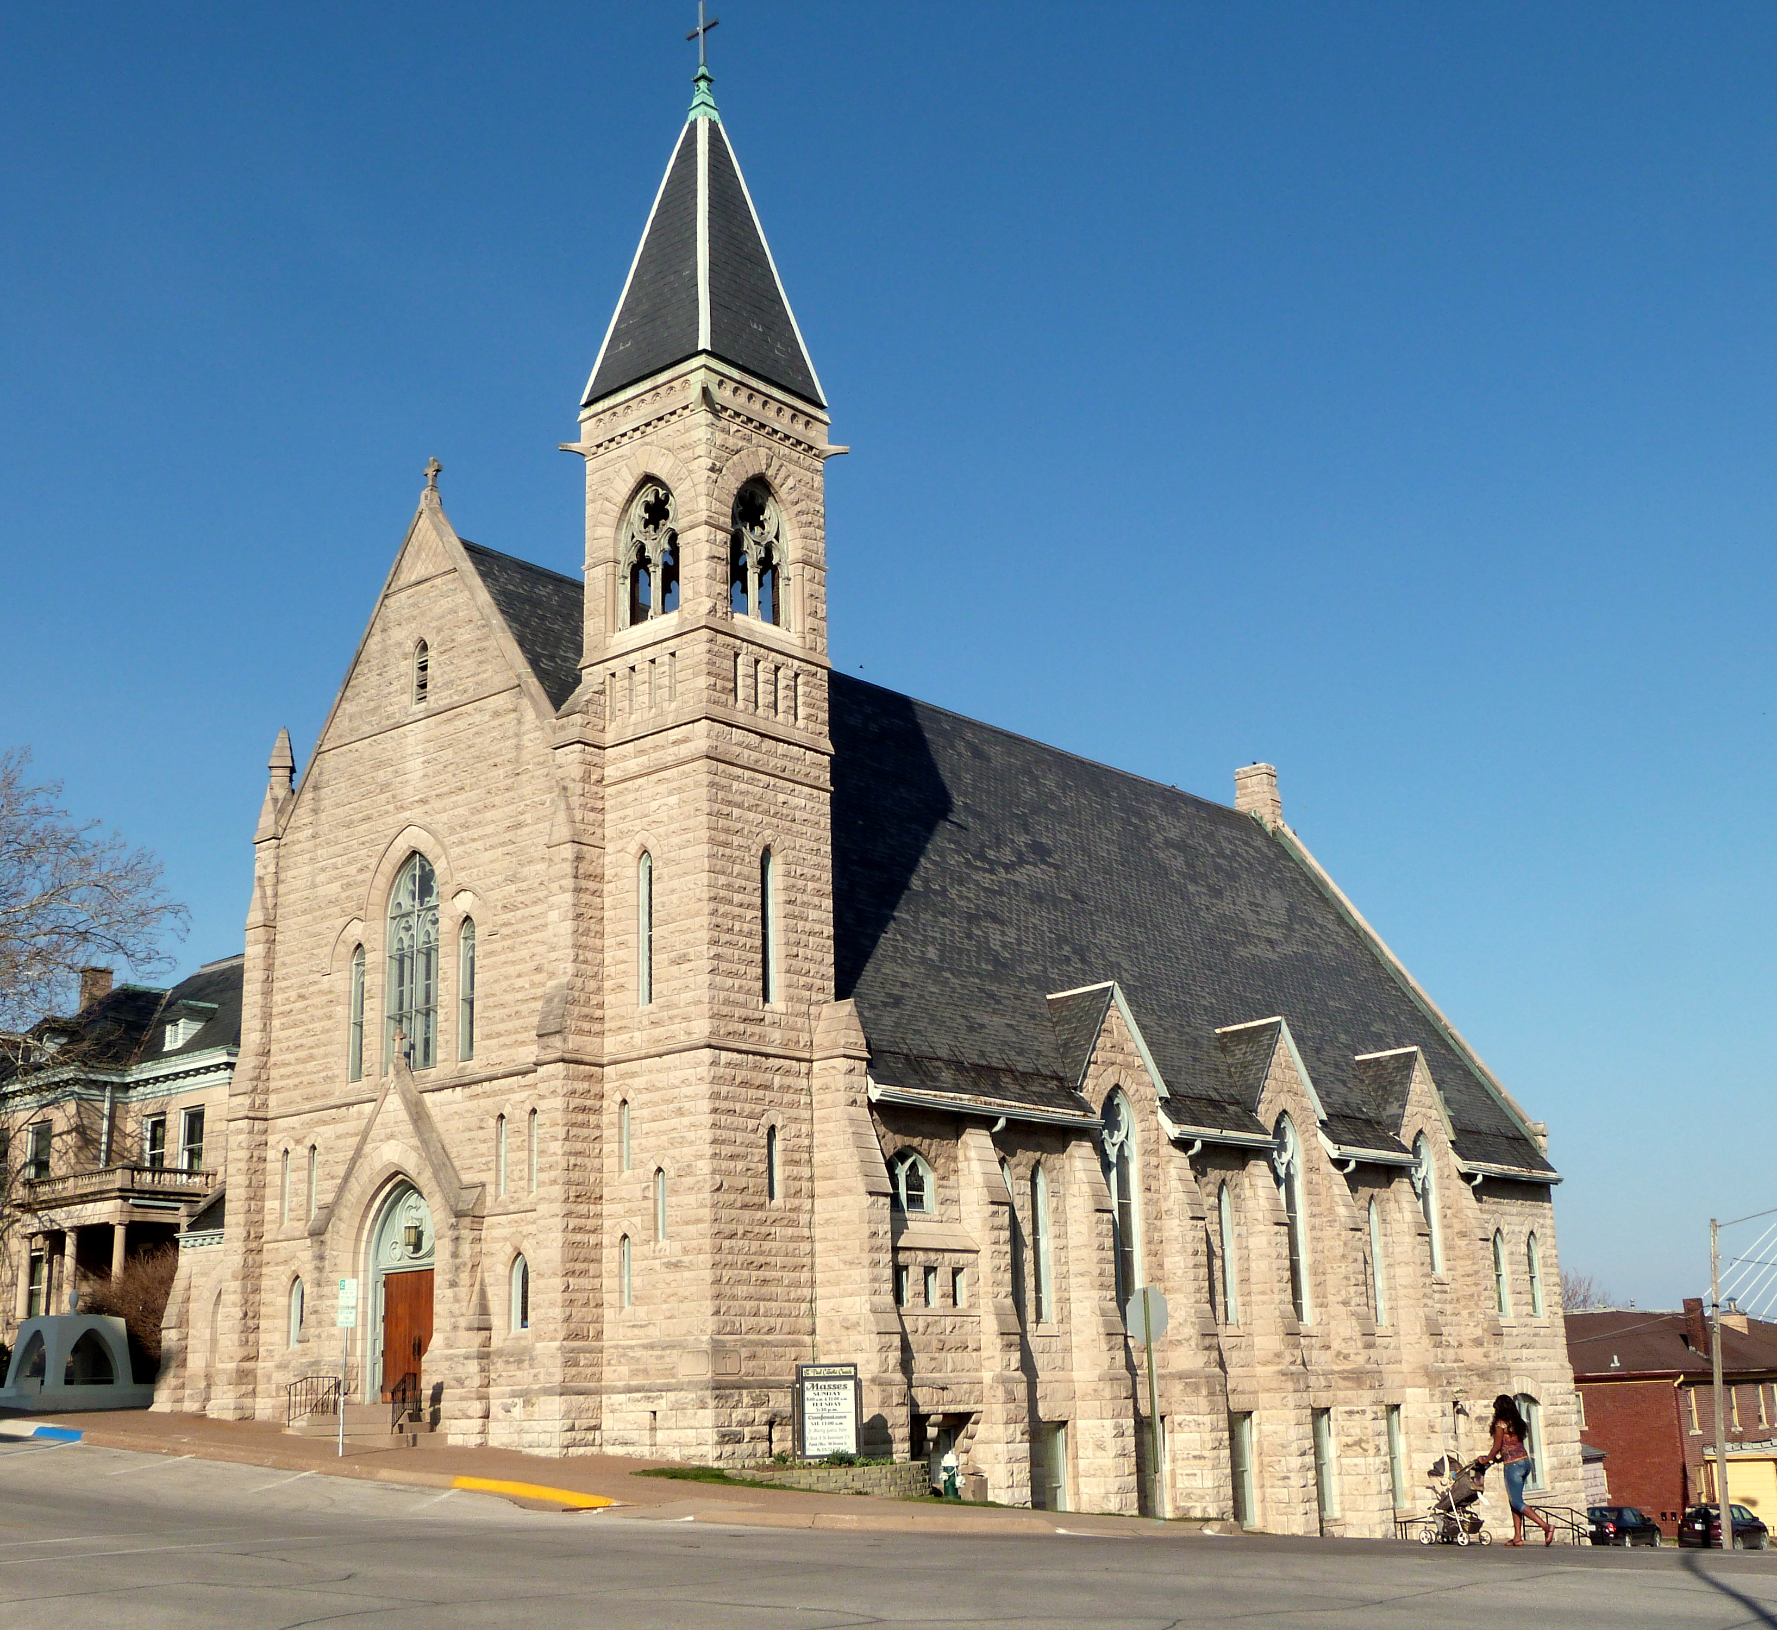
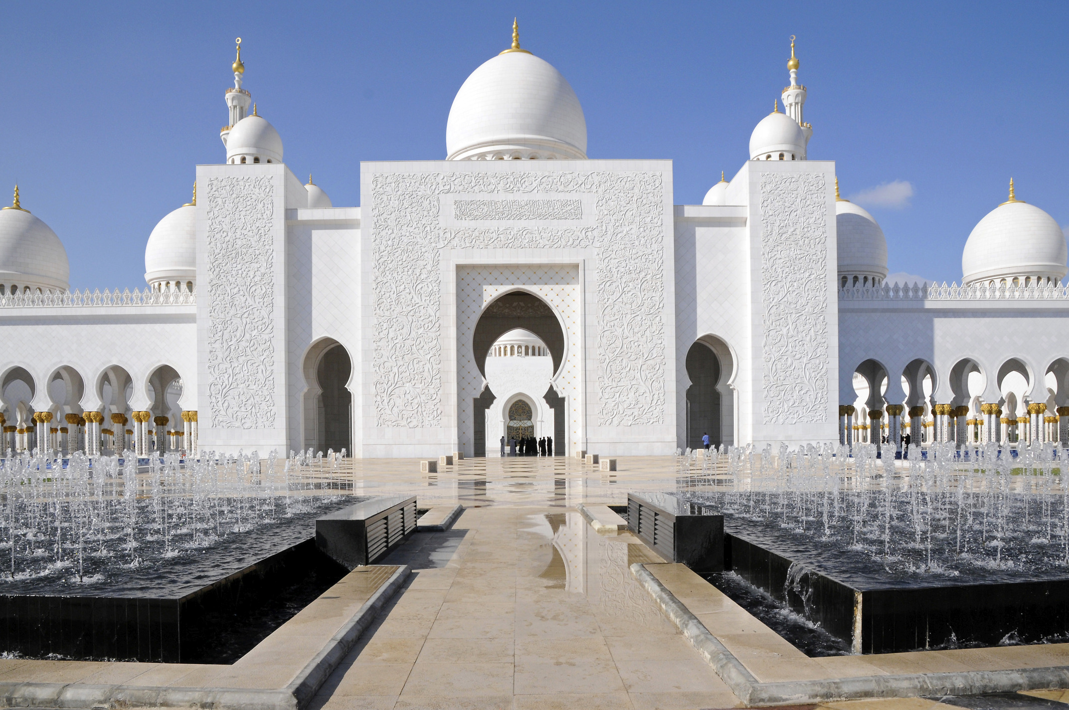
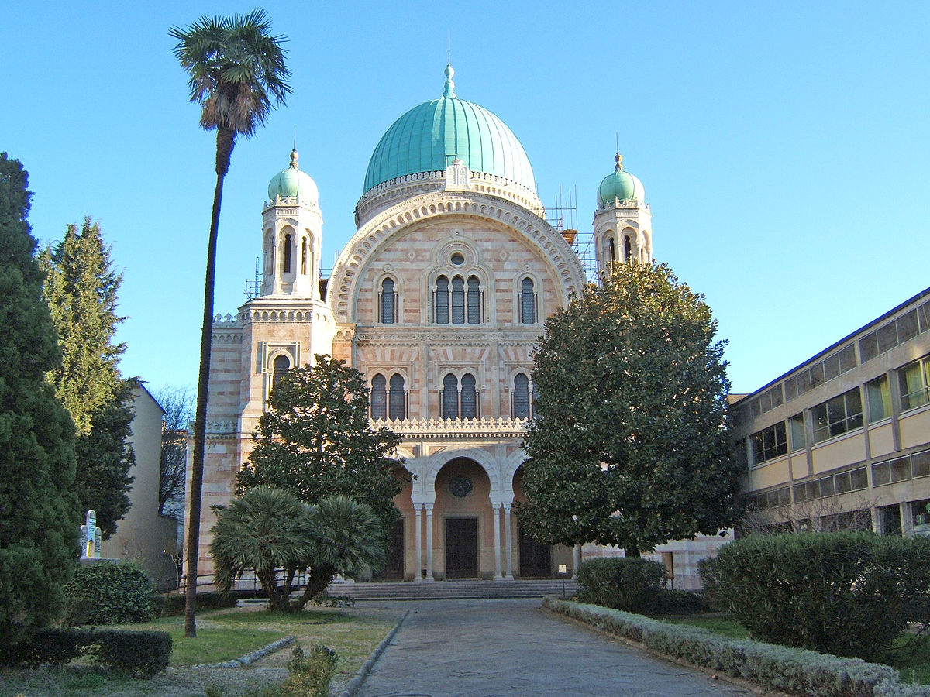
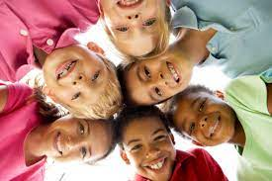
Science
This half term in science, the children will be learning about the weather and the seasons. They will talk about and compare weather using terms such as cloudy, sunny, hot and will learn that there are 4 seasons and that each season has its own weather pattern and temperature.
Geography
The big question this half term is ‘Where do we live?”. The children will be looking at maps and beginning to understand how to locate and describe physical and human features. The children will know how to use directional language to describe the
location of a feature on a map.
Art
This half term in art, the focus is drawing. The children will learn what a drawing is and will explore the use of tone and texture using a variety of different materials. They will then use these new skills to create observational drawings of natural objects.
PE
This half term in PE, the children will be learning about how exercise changes how our bodies feel and what to do if we feel hot or out of breath. As the children develop their sense of space, they will learn to master the underarm and overarm throw. They will learn to catch by forming a nest shape with their hands, how to kick a stationary ball towards a
target and how to pass to a
partner in different ways.
RE
This half term in RE, the children will be learning about places of worship and the definition of religion. They will be finding out about a church, a mosque and a synagogue in more detail. They will be using their 5 senses to describe what it is like inside each of these buildings.
PSHE
This half term in PSHE, the children will be learning some key words to helps them understand what is the same and different about ourselves. They will explore what their likes, dislikes and strengths are and how these make us all unique.
Homework
Please read at least 5x a week and record this in your child’s reading diary.
Please complete a weekly maths sheet that will be sent home.
Suggested books for reading

