Slide 1
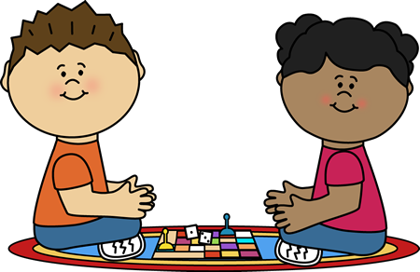
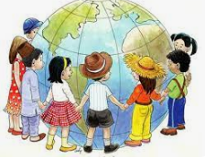
EYFS Newsletter
Autumn 1—2024/2025
Delete and insert academy logo
Notices and Reminders
Our PE day will be every Friday. The children should come to school in their PE kit and trainers.
Please remember to pack a spare pair of clothes in your child’s bag.
Key dates
Reception Parent’s phonics meeting – date TBC
Friday 25 October – last day of Autumn 1
Communication and Language
The communication and language focus this half term is all around settling into school and how the children can use their words to explain their feelings and make friends.
The children will also be working on their listening skills by playing lots of games inside and outside to encourage them to follow simple instructions.
Physical Development
The children will focus on gross and fine motor skills to help them develop their dexterity, strength and coordination. They will practice pre-writing skills, including patterns, holding a pencil and making marks – on a small and large scale.
In P.E. the focus is finding a space and freezing. The children are also learning to change direction when they come to an obstacle.
Personal, Social and Emotional Development
This half term is all about settling into the school environment with a focus on independence and the classroom rules.
The theme is 'Being Me in My World' which covers how it feels to belong and be part of a group along with a focus on their feelings and emotions.

Slide 2
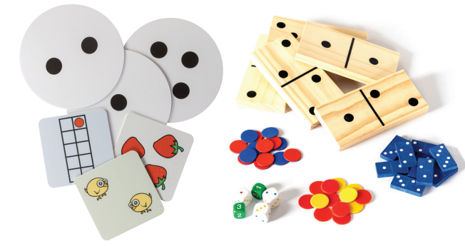
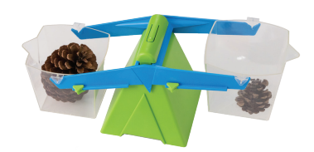
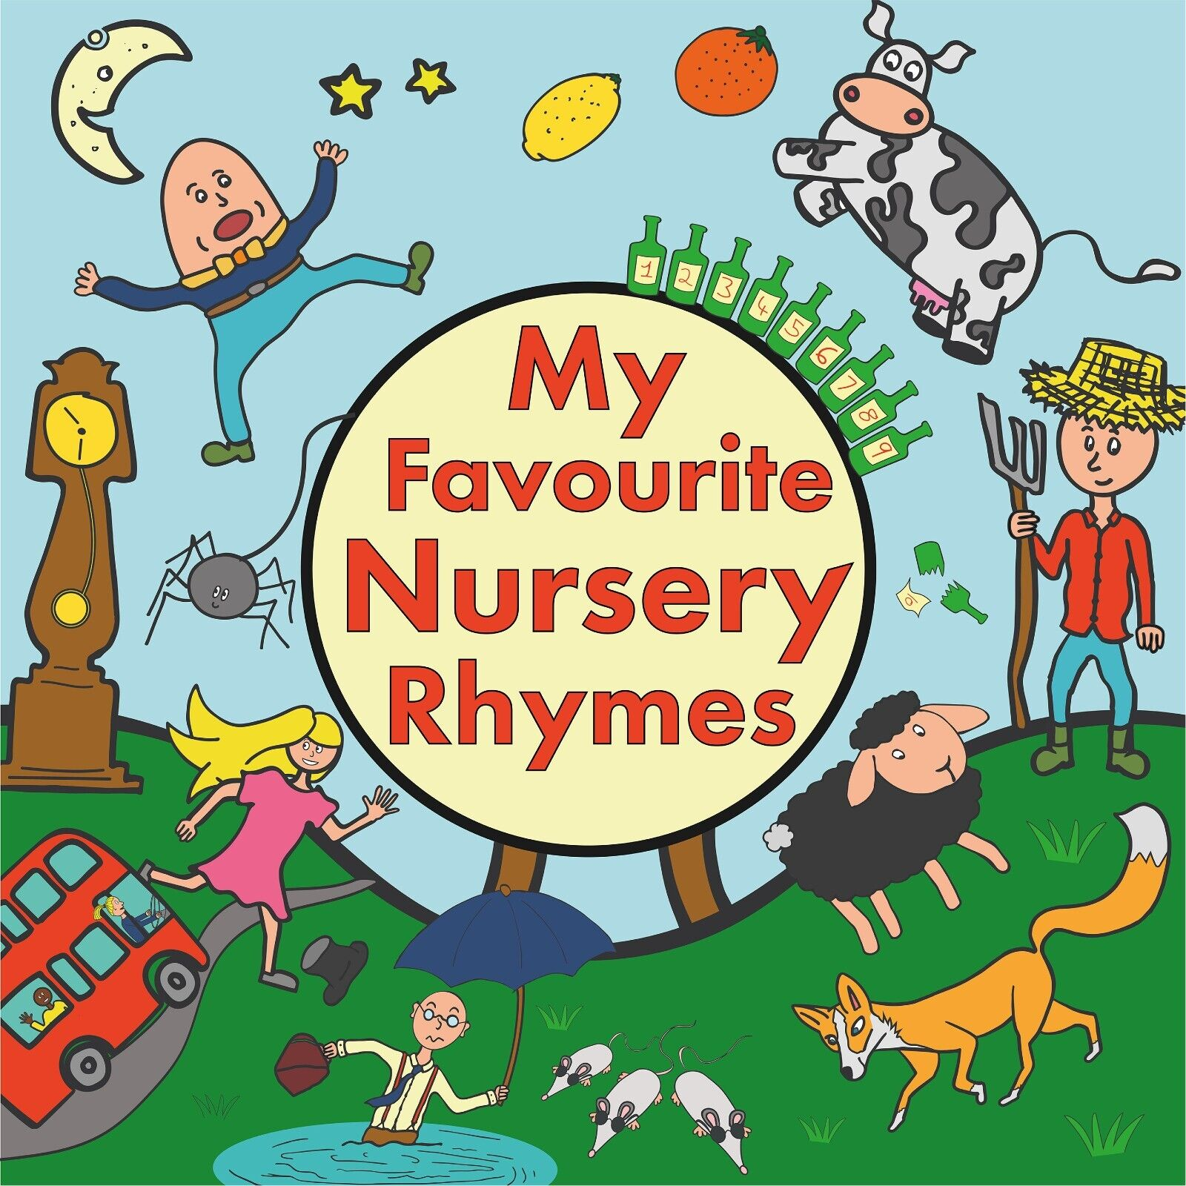
Literacy
'Essential Letters and Sounds' (ELS) is used to develop our children's early reading and writing skills. The children learn 4 sounds each week, we are currently working within Phase 2. They are also learning 'Harder to Read and Spell Words' (HRWs) which cannot be sounded out.
To enhance and embed a love of stories, the children will spend time exploring, learning and asking questions about a story. The key texts will be Elmer, Mixed and The Colour Monster.
Mathematics
Maths this term will include the following areas:
Match, Sort and Compare: the children will find and group objects which match and investigate different ways of grouping them.
Measure and Pattern: The children will compare the size, mass and capacity of objects to say which is greater or smaller.
It's Me, 1,2,3: The children will explore numbers 1-3, recognising sets and dots of these numbers and different ways of making 1,2 and 3.
Recognising circles and triangles.
Understanding the World
The children will be thinking about how they have changed as they have grown, talking about what they can do now compared to what they could do in the past. They will be thinking about their families and how old they are compared to other family members.
The children will be observing the changes that take place in autumn. They will have the opportunity to go outside and look for signs of autumn. They will think about how the change in weather effects animals and learning about animals that hibernate.
Expressive Arts and Design
In music the children will be listening to various pieces of music and talking about why they like or dislike them.
They will sing and perform familiar nursery rhymes identifying the pulse and add their own sounds using their body or instruments.
Homework
Your child will be bring home a reading book towards the end of September. Your child should read this book to you at least 5 times a week. You can mark when you have read together in their reading diary.
You can practice the sounds we have been learning with them too.
You could also explore Autumn with your child by reading books, going on walks and discussing the changes happening.
Suggested books for reading

